Slide 1
The X-Ray Imaging and Spectroscopy Mission
Richard Kelley
NASA Goddard Space Flight Center
Memorial Symposium to Honor
Riccardo Giacconi
Washington, DC
29-30 May 2019
Chandra image
Hitomi/SXS spectrum

Slide 2
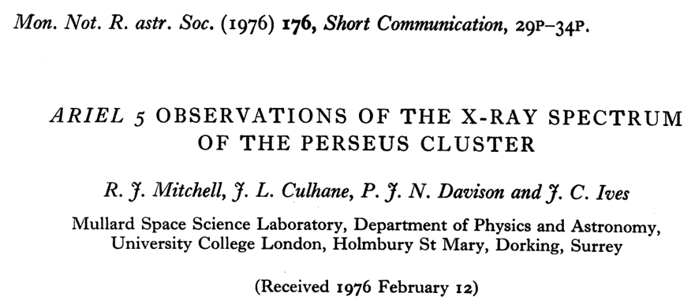
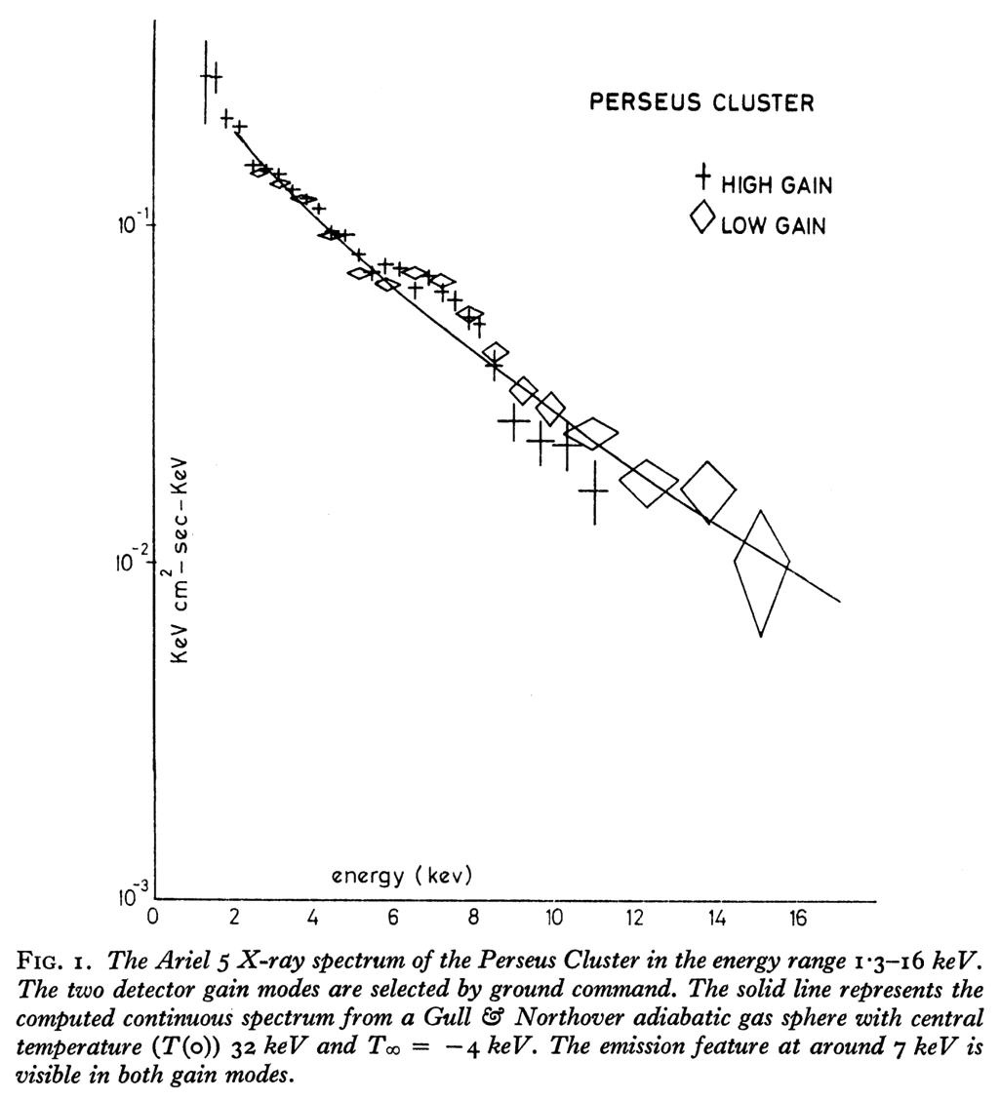
Discovery of X-ray Emission from Clusters of Galaxies
X-ray emission from clusters of galaxies was first detected by Gursky et al., 1971 in the Uhuru X-ray sky survey
Extended (~45 arcmin) source found associated with the Coma cluster.
Similar extended cluster X-ray sources were later discovered (e.g. Perseus, Virgo), but the spectra at the time were insufficient to distinguish between power law and thermal bremsstrahlung spectra.
Two possible mechanisms were proposed:
Inverse Compton radiation from 3 K microwave background photons interacting with a relativistic electron population in the cluster (Brecher and Burbidge, 1972).
Thermal bremsstrahlung from a hot isothermal gas (Lea et al., 1973).
Fe K emission

Slide 3
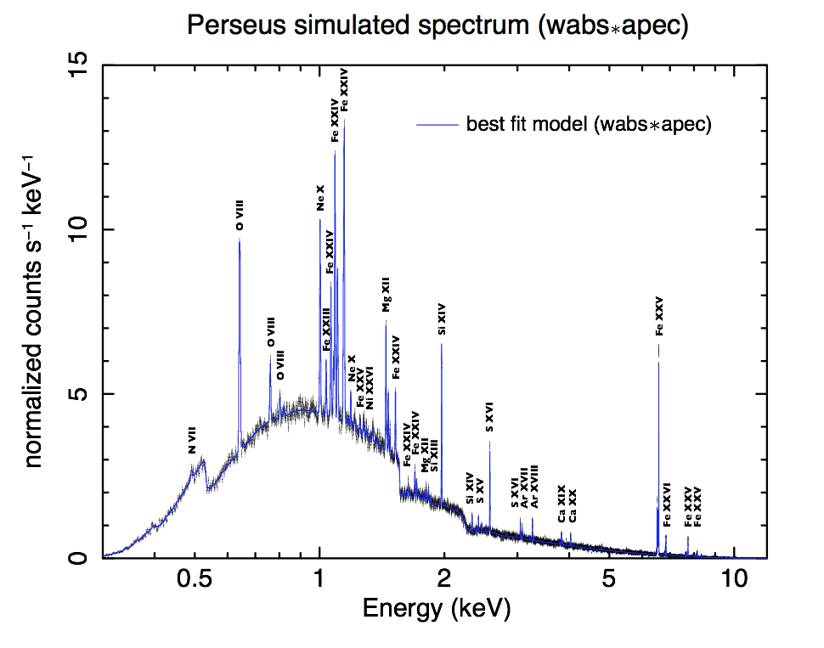
Expected X-ray spectrum of intra-cluster medium

Slide 4
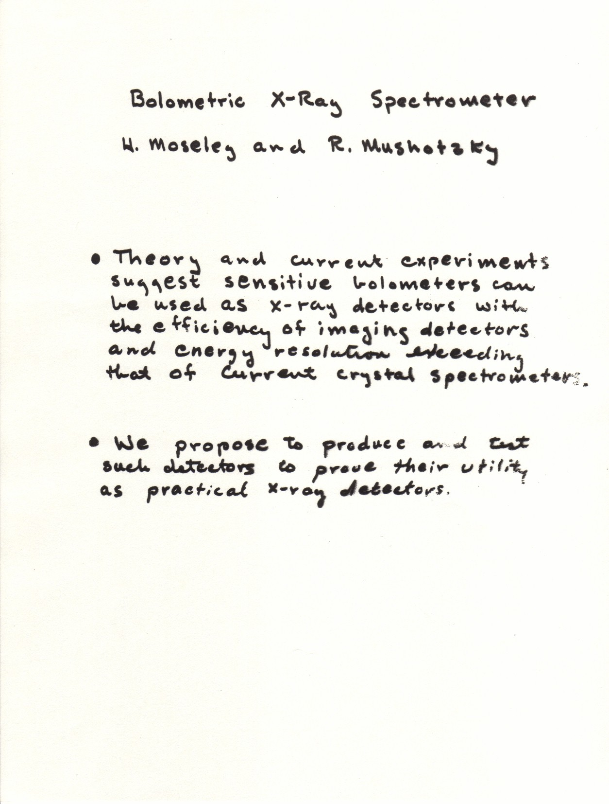
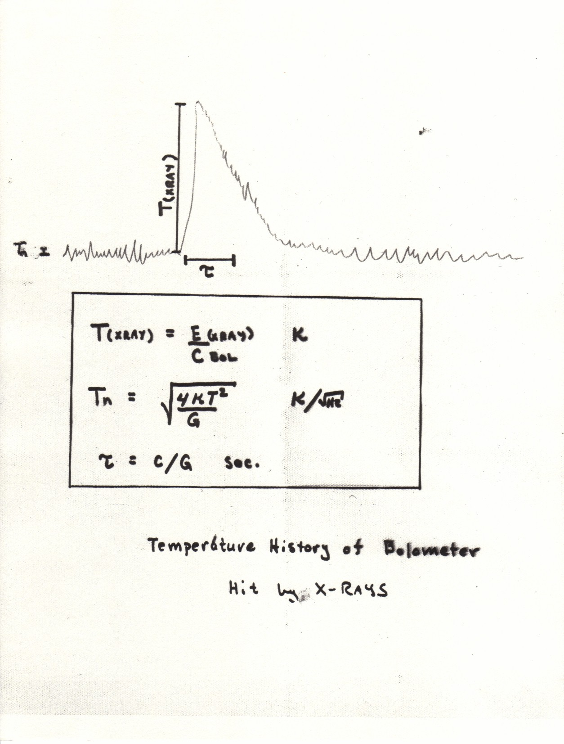
X-Ray Calorimeter (1982)
Energy resolution of ~ 1 eV theoretically possible

Slide 5
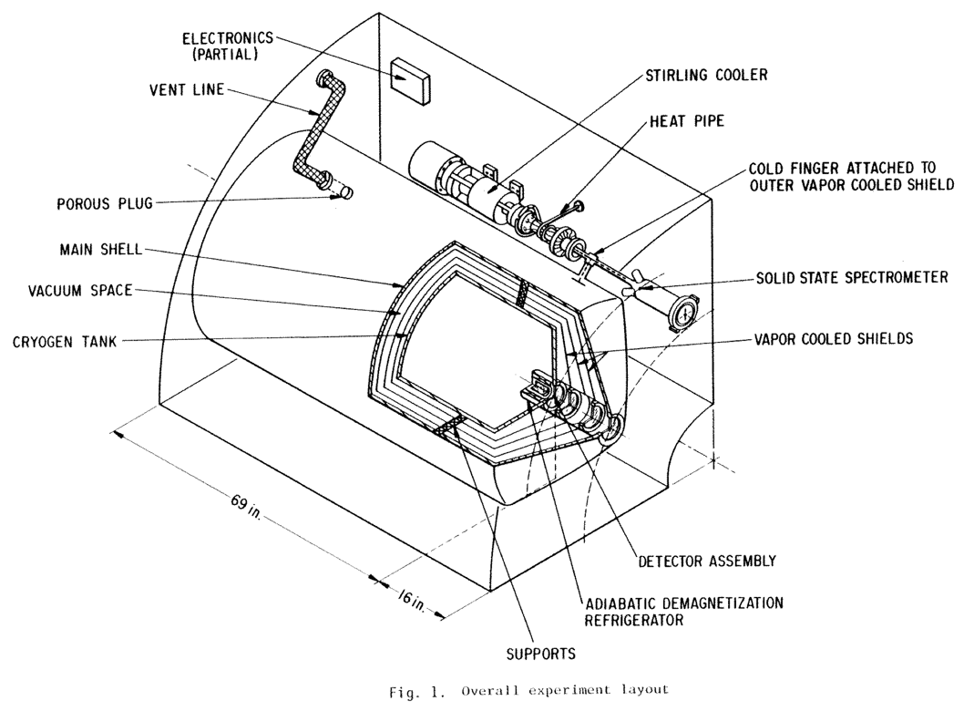
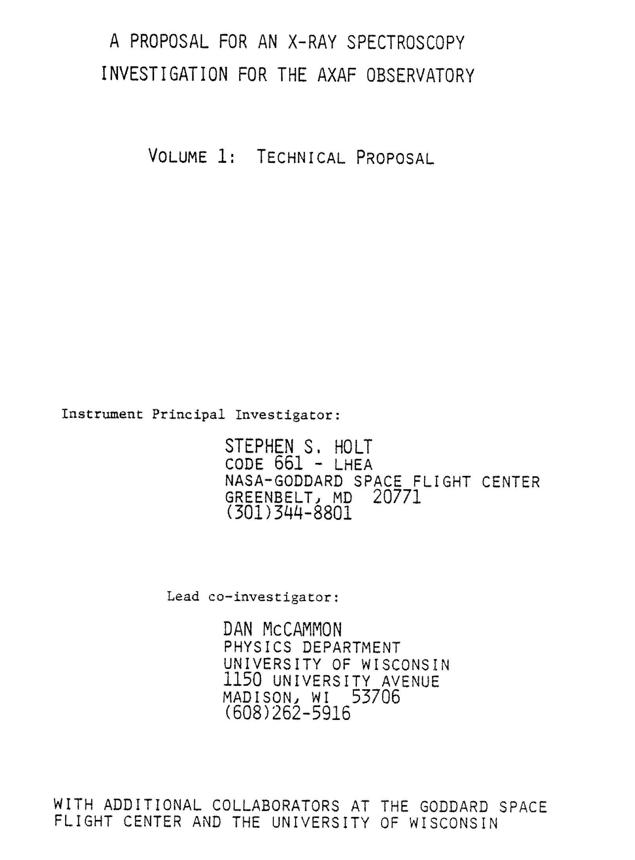
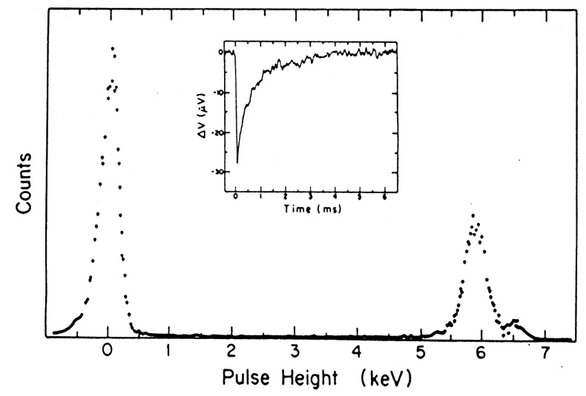
The AXAF X-Ray Spectrometer (XRS)
≈ 140 eV resolution

Slide 6
The “XRS” is History!
AXAF
AXAF-I AXAF-S
1993
Astro-E
2000
AXAF
Astro-E2
2005
Chandra
Astro-H
2016
XRISM
2022

Slide 7
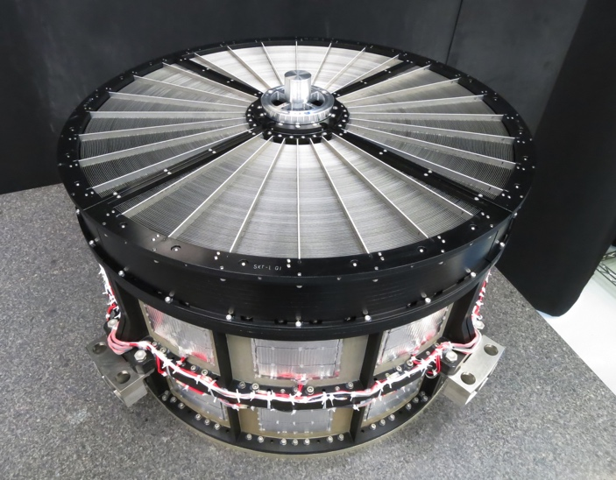
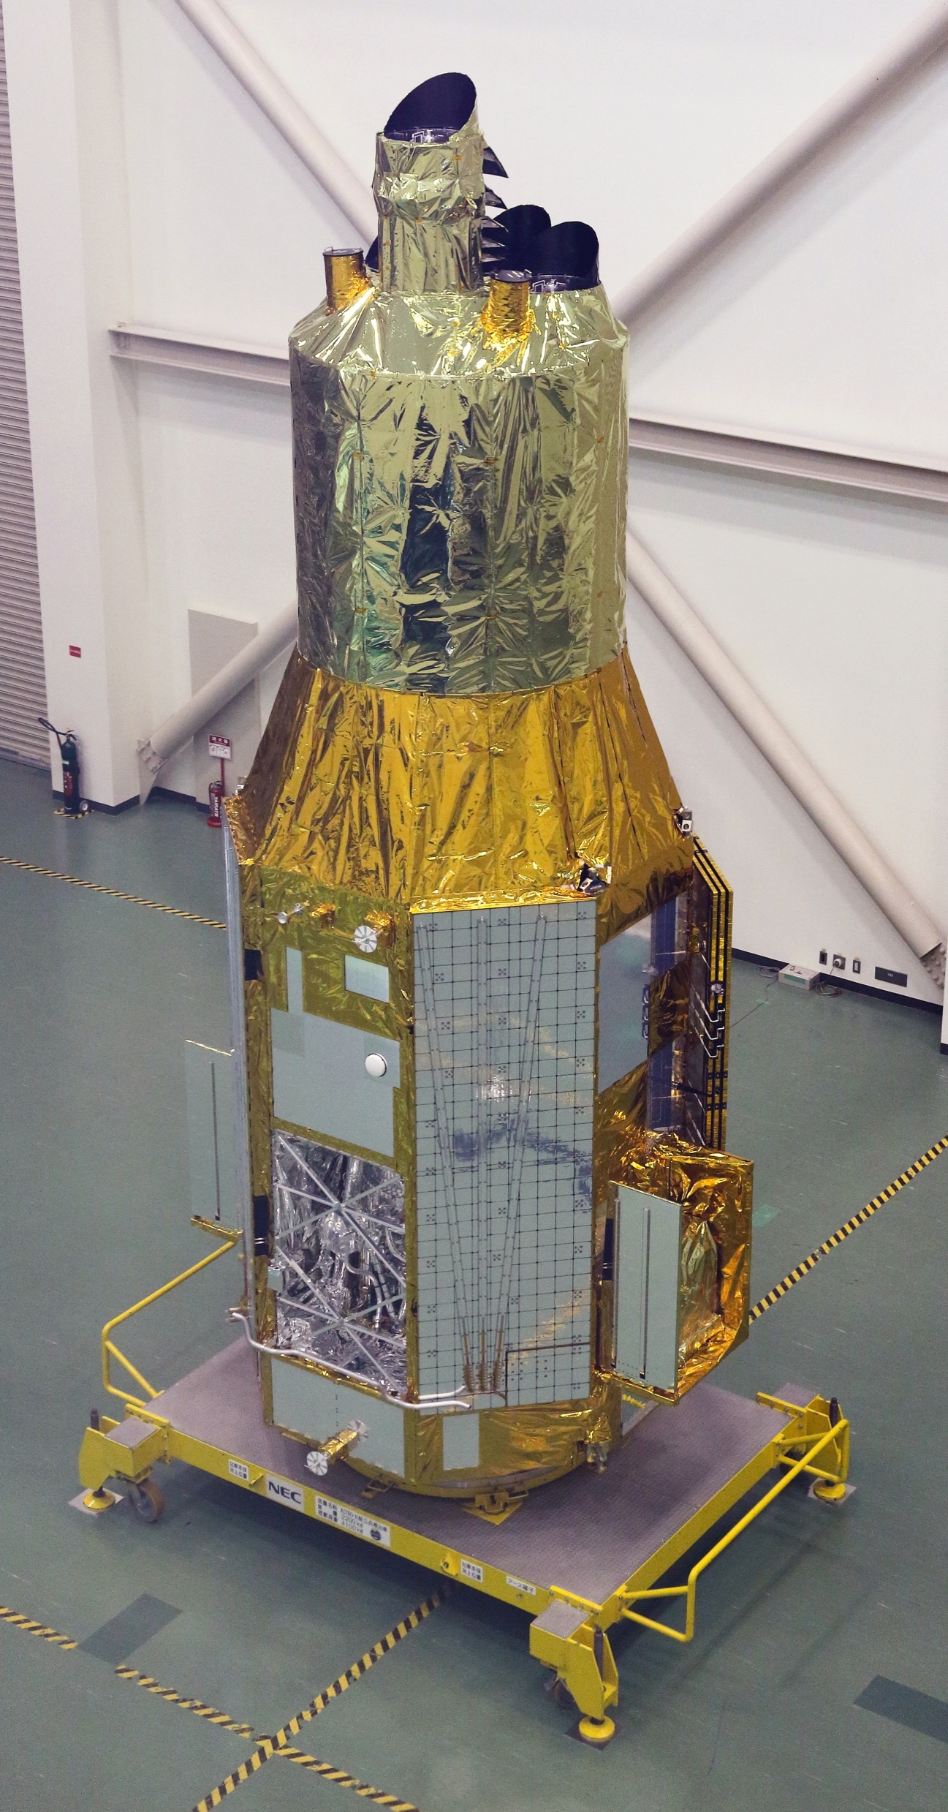
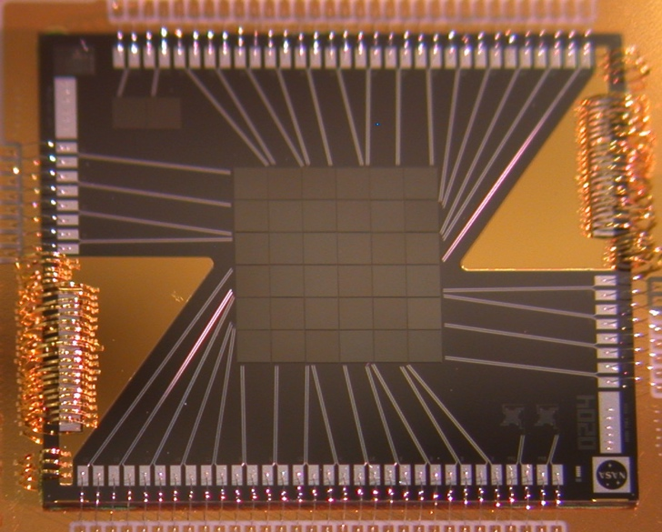
NASA Hardware Contributions to Astro-H
Soft X-Ray Spectrometer
SXS – energy resolution better than 4.9 eV at system level
6 x 6 array of 30” x 30” pixels (3 arcmin FOV)
Soft X-Ray Telescope
5.6 m focal length – fixed optical bench
203 concentric shells (1624 individual reflectors)
Outer Diameter: 45 cm
Mass: CBE = 46 kg.
Half-Power Diameter of better than 1.2 arcmin

Slide 8
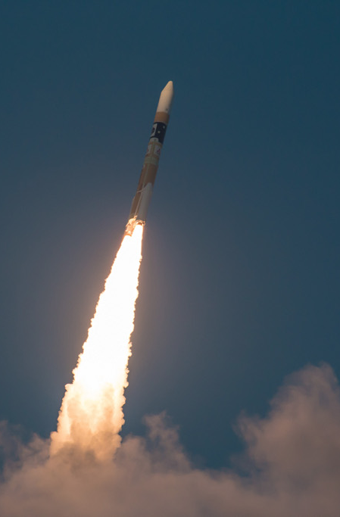
1st Astro-H target – Perseus Cluster
(Chandra image, Fabian et al.)
Astro-H launch
Feb 17, 2016 JAXA HII-A

Slide 9
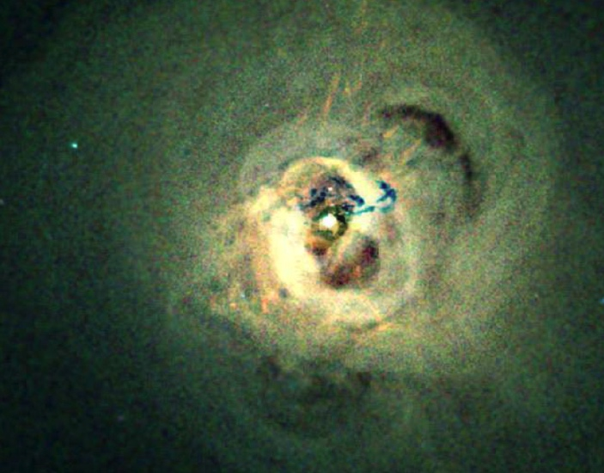
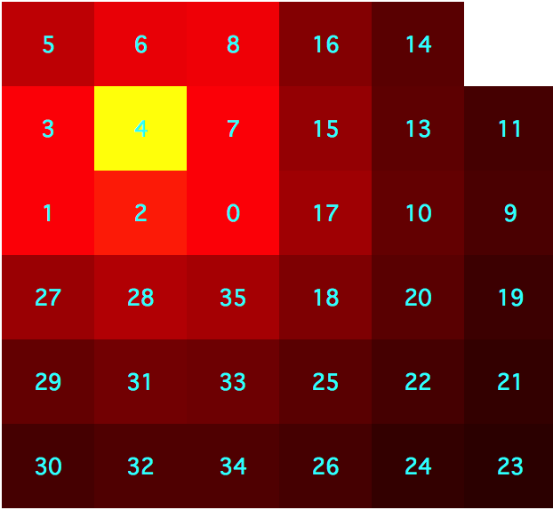
1st Astro-H target – Perseus Cluster
(Chandra image, Fabian et al.)
3 arcmin ~ 60 kpc

Slide 10
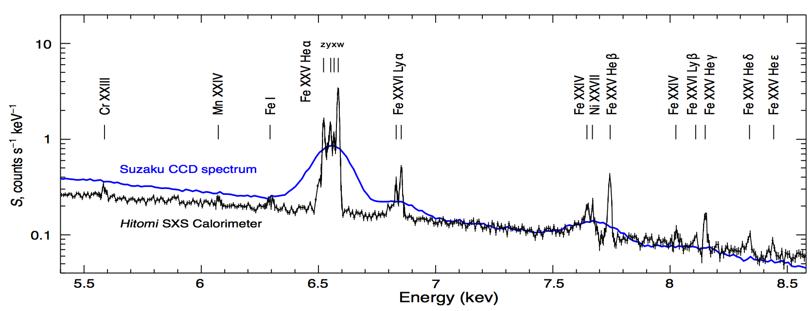
Astro-H (Hitomi) SXS Spectrum of Perseus cluster
Hitomi Collaboration, Nature 2016
BLACK: Hitomi SXS (energy resolution 4.9 eV, FWHM)
BLUE: Best previous spectrum (Suzaku CCD; FWHM 140 eV)

Slide 11
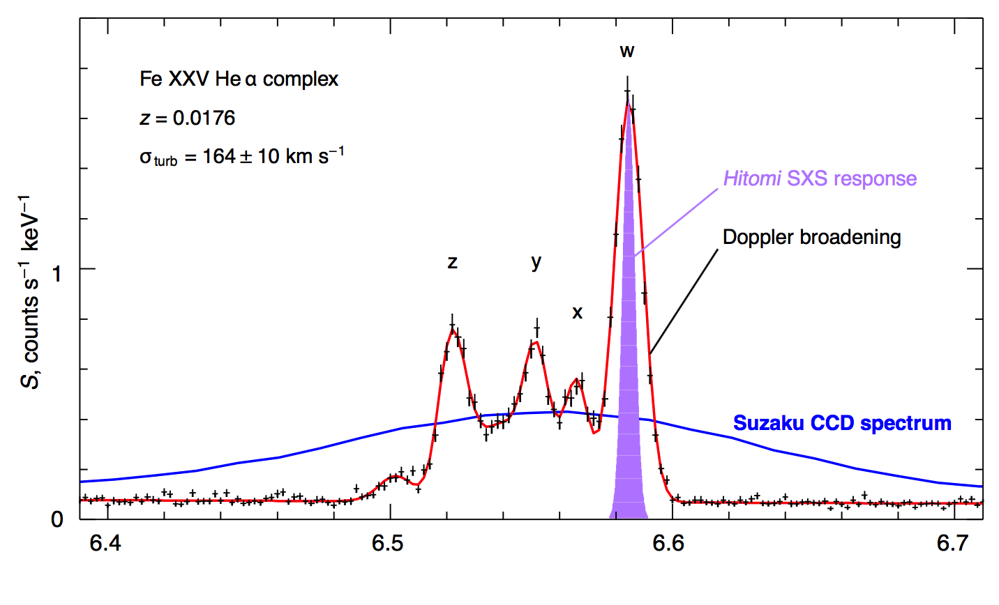
Astro-H (Hitomi) SXS Spectrum of Perseus: He-like Fe
σ_{turb} = 164 ± 12 km s⁻¹
P_{turb} < 0.04 x P_{thermal}
Energy (keV)
Hitomi Collaboration, Nature 2016
BLACK: Hitomi SXS data
PURPLE: Hitomi SXS line response function
BLUE: Best previous spectrum (Suzaku CCD)
Notice how the high spectral resolution of Hitomi/SXS allows easy detection of the turbulent velocity broadening. This capability was eagerly anticipated for all nearby clusters.

Slide 12
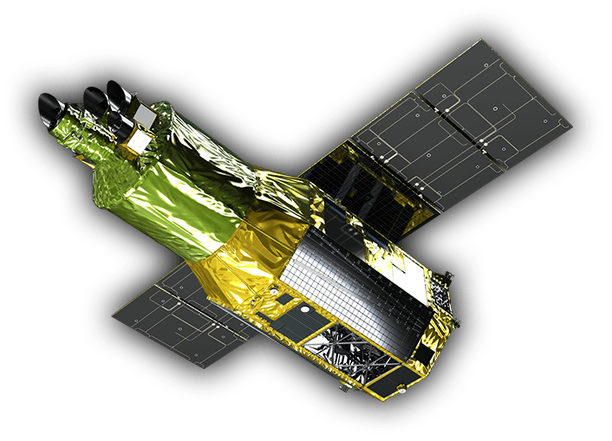
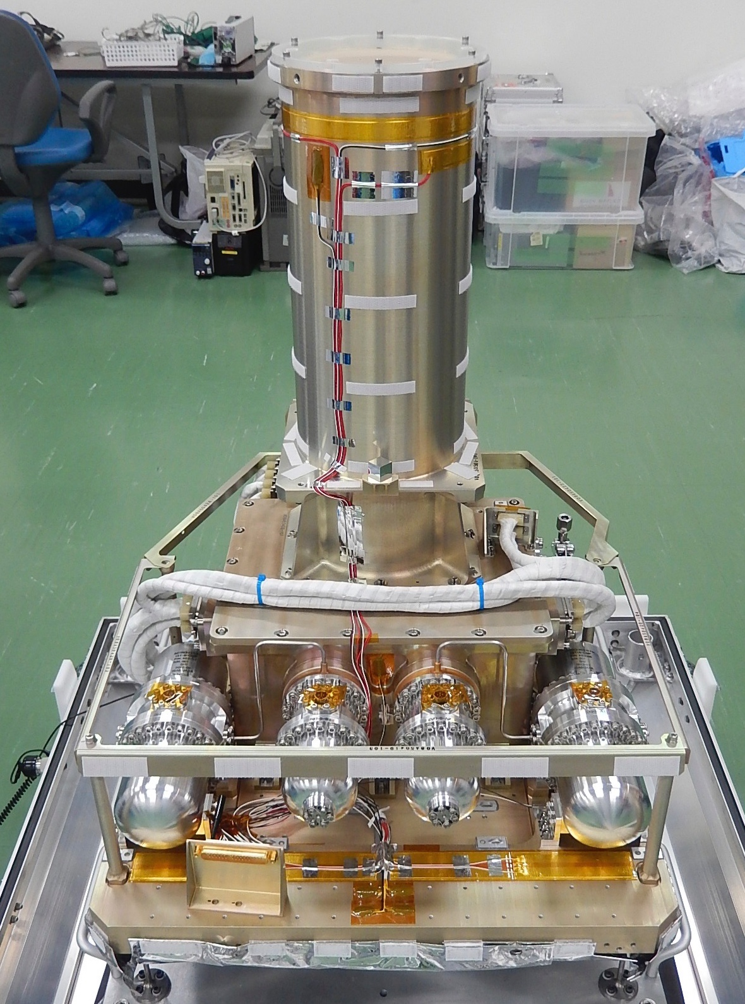
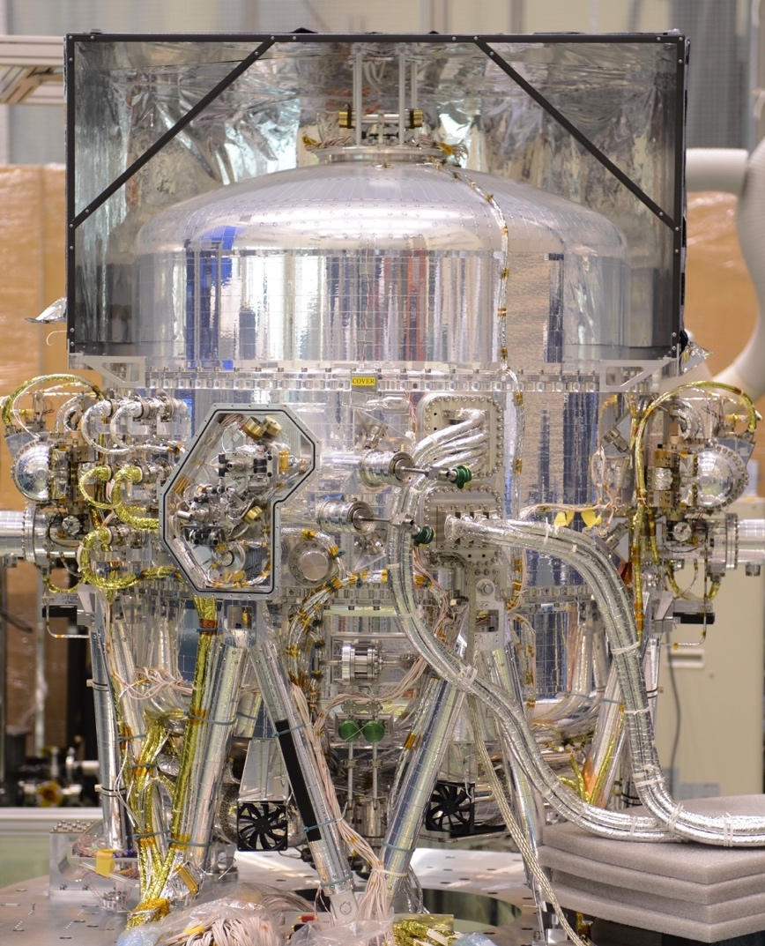
The X-Ray Imaging and Spectroscopy Mission
X-Ray Mirror Assemblies (2)
Coming in 2022
Incorporates many lessons learned from Astro-H
Xtend CCD Imager
Resolve X-Ray Spectrometer

Slide 13
US Access to XRISM
NASA to have access to ~ 44% of observing time and all data from Resolve and Xtend once in US archive (+1 year). JAXA and ESA have separate agreement on remainder.
NASA responsible for data pipeline and dissemination.
NASA Participating Scientists selected by NASA (science advisors):
Lia Corrales/U. Michigan Erin Kara/MIT Jon Miller/U. Michigan
Paul Plucinsky/SAO Irina Zhuravleva/U. Chicago
Additional target Collaborating Scientists to be selected to support performance/verification phase (6 months duration following commissioning)
It is anticipated that ~ 60 scientists will be selected to join target teams.
AO for Collaborating Scientists to be released in late 2020.
Negotiating early release data from a few targets shortly after commissioning.
AO-1 released after commissioning (~ late Spring, 2022).

Slide 14
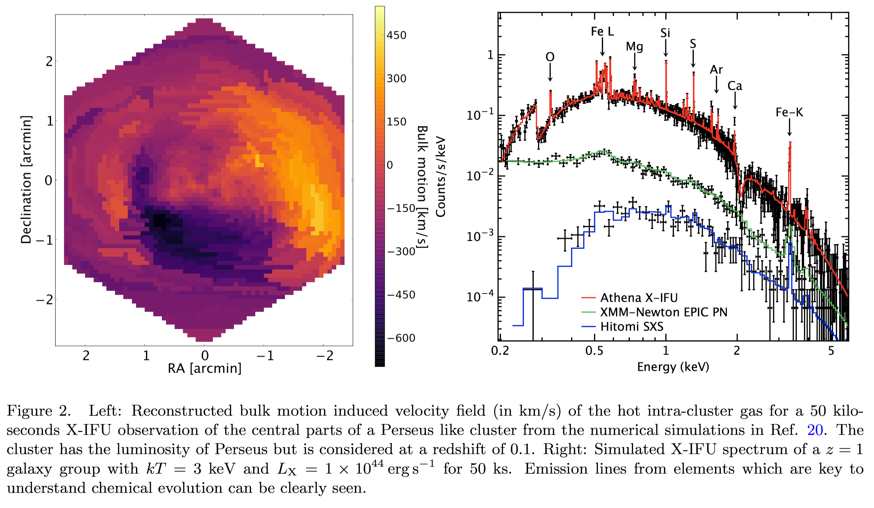
Giant leap: ATHENA will push capability all the way out to z ~ 1
Contains very large fraction of all x-ray clusters
3168-pixel array, 2.5 eV resolution
14
Memorial Symposium to Honor Riccardo Giacconi

