Slide 1
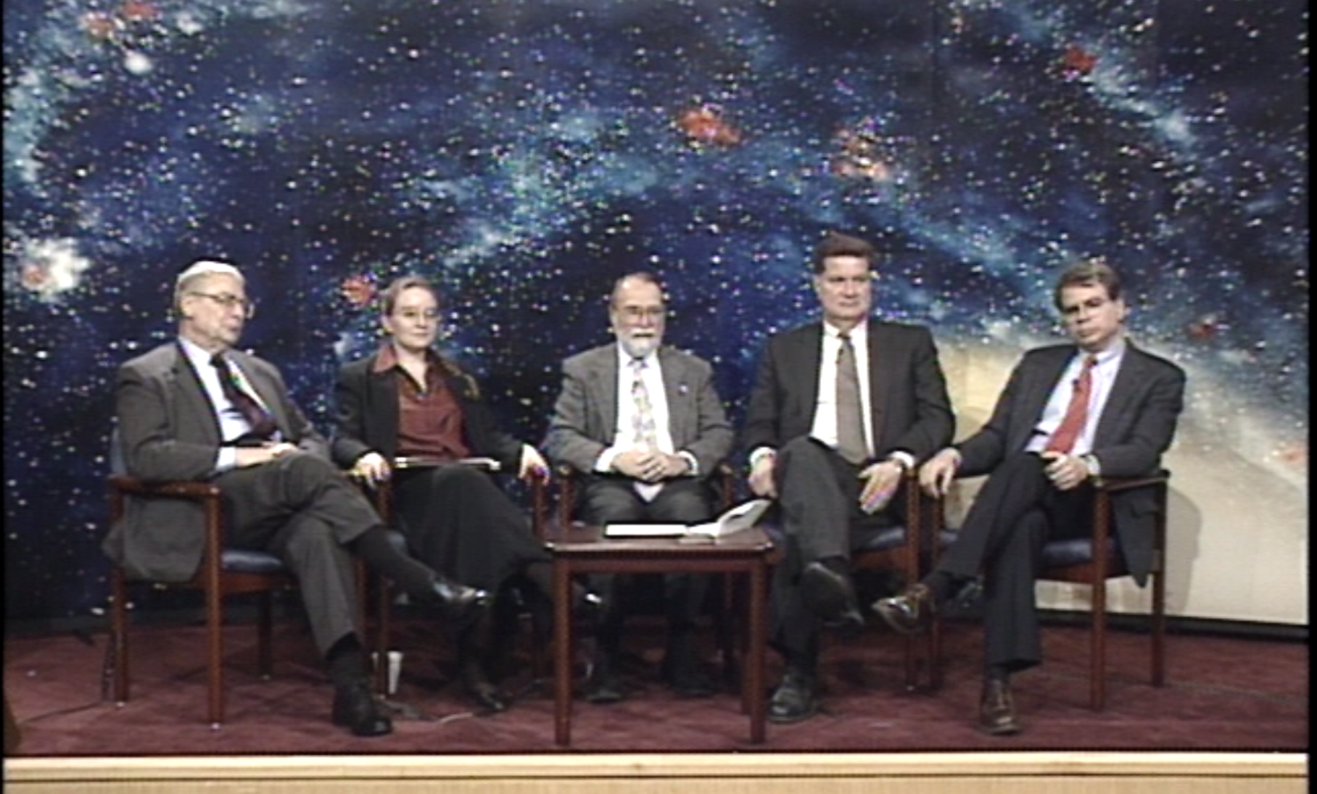
The whisper of the faintest X-ray sources and the loud influence of Riccardo Giacconi
March 13, 2001
Seeing the Unseen: Chandra Deep Fields
Space Science Update @ NASA HQ
THANKS to Sheva Moore and team at NASA TV
Jaisawal
Ann Hornschemeier
Lab Chief, X-ray Astrophysics (NASA GSFC)

Slide 2
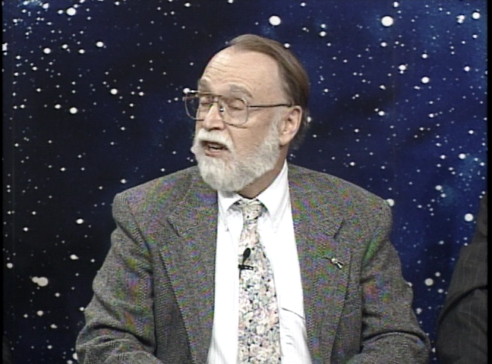
What was it like sitting next to Riccardo?

Slide 3
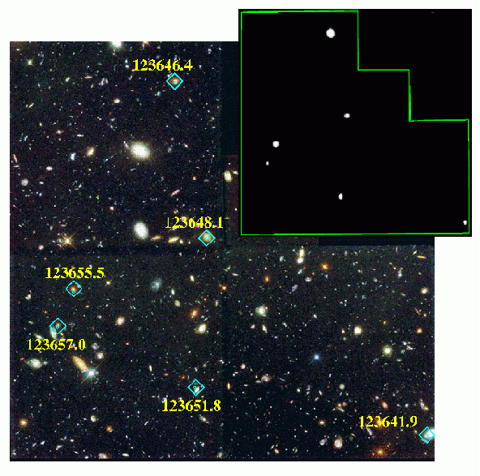
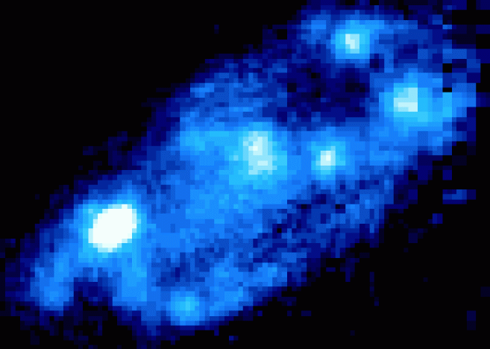
First Views of the X-ray Sky with Chandra
(166 ks)
Normal galaxy with ULX among first six objects detected in HDF-N
HST f300w ≈2” X 3”

Slide 4
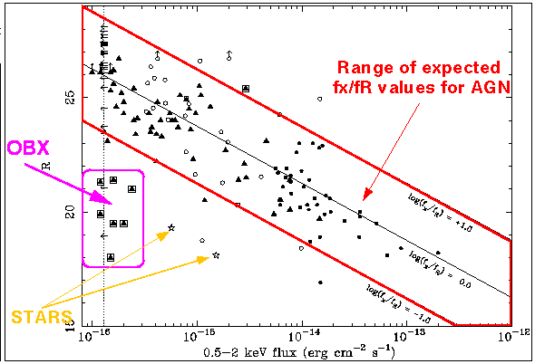
Optical properties of CDF-N Sources, 221 ks
“New” population seen to arise (just past 166 ks)
^{Hornschemeier et al. (2001)}
Notes:
Recall that in the ROSAT and ASCA era it had been found that the X-ray background was made by AGN and that the vast majority of the sources discovered were AGN.
It had also been found that AGN (both moderately obscured and unobscured) exist in a certain range of X-ray to optical flux ratio.

Slide 5
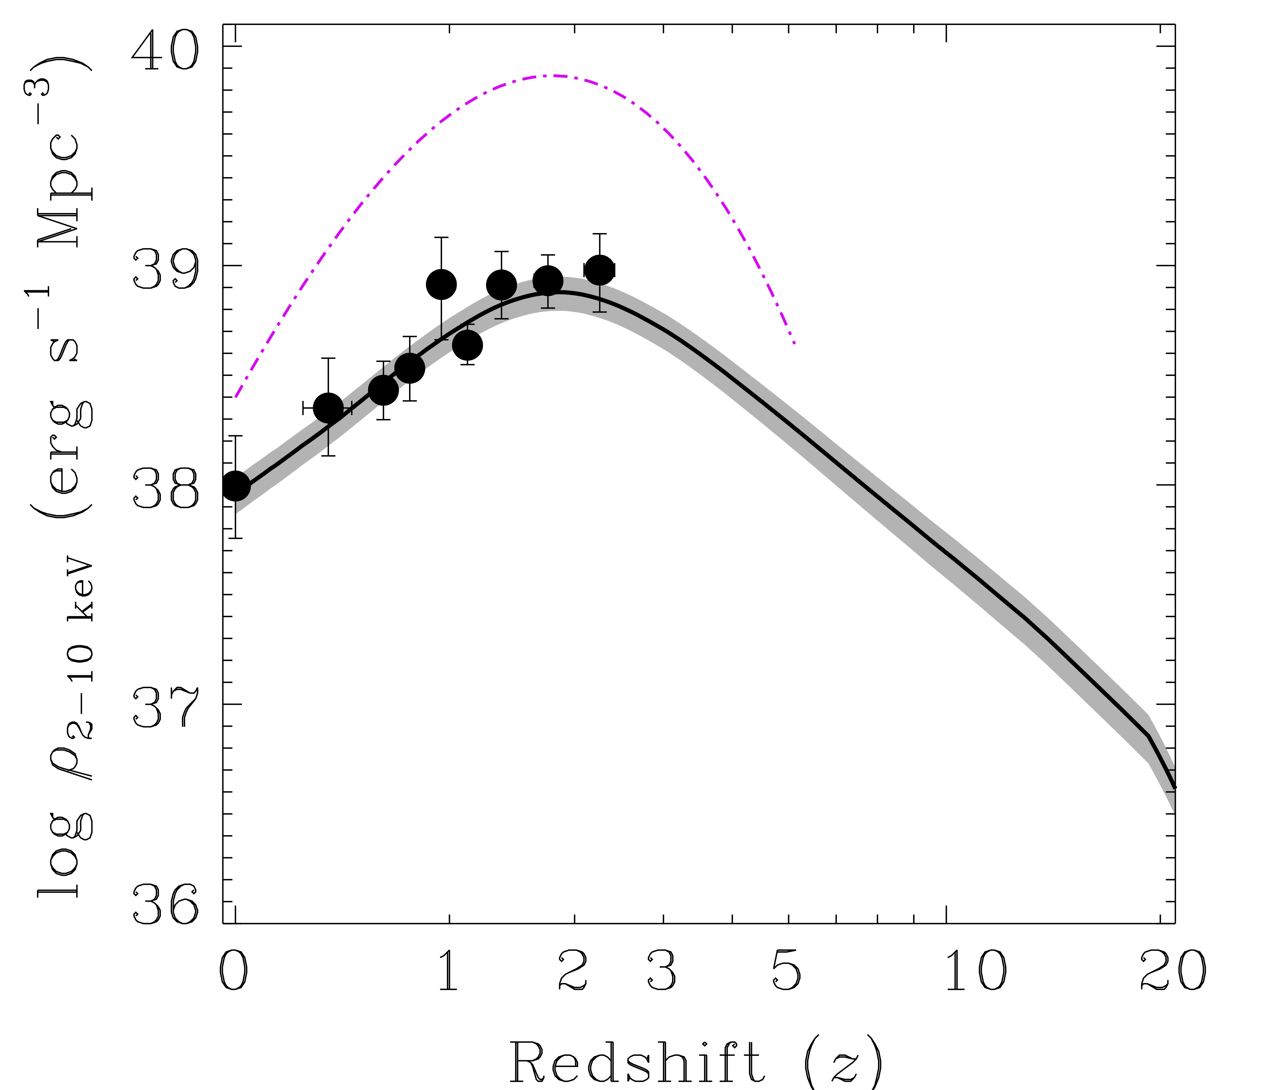
The X-ray output of binaries exceeds that of AGN at z>6
Supermassive Black Holes
(Aird et al. 2015)
COSMIC
DAWN
X-ray Binaries from Galaxies
(Lehmer et al. 2016)

Slide 6
X-rays from star formation affect the primordial IGM at z≈20
(courtesy A. Mesinger)
The X-ray mean free path through the IGM is very sensitive to E_{x}: thus the patchiness of the heating tells us about the X-ray SED
Notes:
Again, we see the imprint in the IGM of photons we would otherwise not be able to see!

Slide 7
High-z 21 cm observations (HERA, SKA, etc.):
Softer SEDs result in more inhomogenous IGM heating
‘hard’ SED ~ HMXBs
‘soft’ SED ~ hot ISM
750 Mpc
Pacucci, AM+ 2014
Notes:
21cm intensity at the time where the temperature term dominates the signal. red is heated

Slide 8
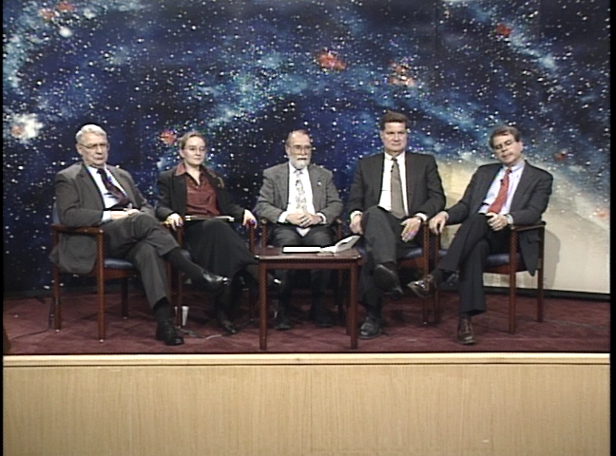
Sharing a laugh with Riccardo
Notes:
What we cannot do with Chandra…

Slide 9
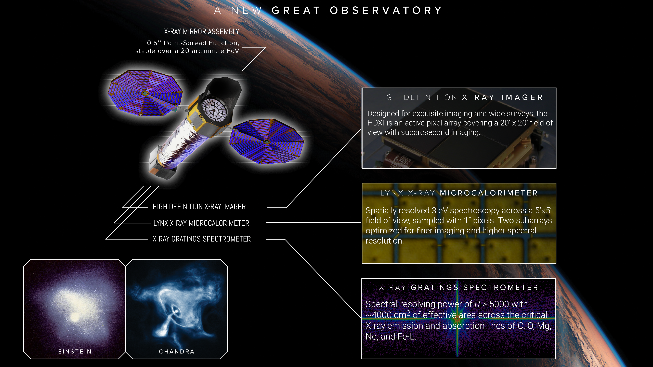
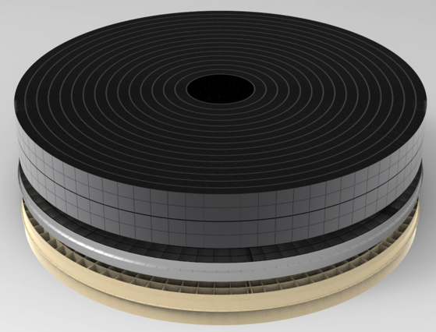
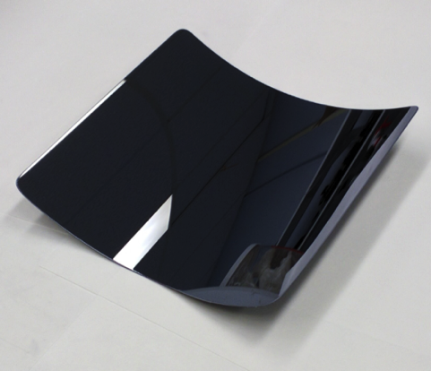
Lynx: a new great observatory for X-ray astronomy
Reference mission baseline optics technology:
GSFC silicon metashells
Microcalorimeter arrays developed at GSFC:
Notes:
These images illustrate the evolution of the X-ray view of Crab Nebula from Einstein to Chandra. Lynx vs. Athena will be a similar jump in spatial resolution, while Lynx vs. Chandra will be a simIlar jump in collecting area.
The heart and sole of the observatory is the mirror. Lynx aims to preserve Chandra's spatial resolutions ($0.5''$) while providing a massive increases in the throughput.
LONGER DESCRIPTION OF THE INSTRUMENTS:
HIGH DEFINITION X-RAY IMAGER: The High Definition X-ray Imager is Lynx’s sharpest eye, melding the exquisite spatial resolution and PSF stability provided by the mirrors. The HDXI is optimized for high-resolution imaging across wide survey areas. It will have moderate spectral resolution (100 eV) over 0.1–10 keV, and excellent image quality. Fine, 0.3 arcsecond pixels, will cover a 20’ × 20’ field of view. The point spread function will remain highly stable even at large off-axis angles, as the detectors will tilt to follow the optimal focal surface. This will enable Lynx to survey the X-ray sky 800 times faster than Chandra at faint flux limits.
LYNX X-RAY MICROCALORIMETER: Long the dream of X-ray astronomy, the X-ray microcalorimeters can achieve unprecedented spectral resolution. Only Lynx couples the exquisite spectral resolution of a microcalorimeter to sub-arcsecond spatial resolution. This will enable collection of truly three dimensional data, realizing the full potential of this transformational technology. The Lynx X-ray Microcalorimeter (LXM) will enable spatially resolved spectroscopy across a 5’ × 5’ field of view, sampled with 1 arcsecond (50 micron) pixels, at an energy resolution of 3 eV. That’s 90,000 pixels. Two subarrays will be optimized for sub-arcsecond imaging and maximal spectral resolution (ΔΕ ~ 0.3 eV below 1 keV).
X-RAY GRATINGS SPECTROMETER: An even higher spectral resolution is required for absorption-line studies of diffuse baryons in galactic halos and in the Cosmic Web, physics of stellar coronae, and assessing the impact of stellar activity on habitability of their planets. This capability will be provided by the X-ray Grating Spectrometer (XGS). The XGS gratings arrays can be inserted into and removed out of the optical path. These arrays will cover 2/3 of the input aperture, providing 4,000 square cm of effective area at the astrophysically important X-ray lines in the 0.2–2 keV band. The dispersed spectrum will be read out with a dedicated array of Si-based sensors. The resolving power will be fairly uniform across the band, at R > 5,000.

Slide 10
X-ray astronomy owes a huge debt
of gratitude to Riccardo Giacconi.
Thank you!
Ann.Hornschemeier@nasa.gov

Slide 11
But we can learn more!
The X-ray mean free path through the IGM is very sensitive to E_{x}: thus the patchiness of the heating tells us about the X-ray SED
Notes:
Again, we see the imprint in the IGM of photons we would otherwise not be able to see!

