Slide 1
Riccardo Giacconi’s Legacy!
Notes:
I did not know Ricardo personally beyond being introduced a few times, which he never recalled the next time! However, as I am sure is true of many of us here, without him I would not have had the career I have now.
As I am sure many of you know, 2019 is Chandra’s 20th year of operation.
This is a beautiful, accurate as launched, image of the satellite newly minted for the 20th anniversary. In my, Chandra-related view, Chandra’s success and its science IS Riccardo’s Legacy!

Slide 2
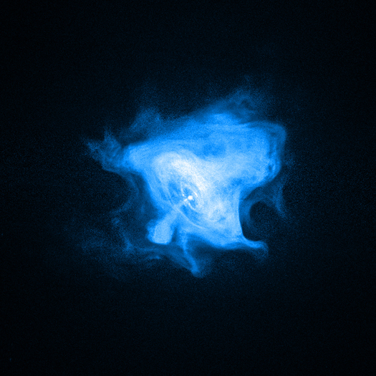
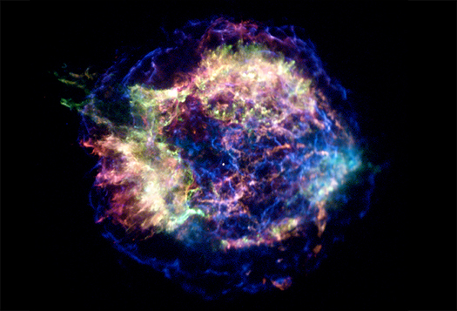
The World’s Premier X-ray Observatory
Uniquely high spatial resolution, ~0.5”, matching ground-based optical telescopes
Uniquely high spectral (>1000) and timing (~16µs) resolution
Field-of-View: Maximum 30’ square (HRC)
Lifetime: 25-30 years, (~9 more) of operation
High Impact on Astrophysics:
Science Papers: >7700
~450 papers/yr
Citations/paper: >35 after 6 years
>4300 PIs&CoIs
High Impact on Public via Press, website, social media etc.
Crab
Cas A
Notes:
As a reminder, I give here Chandra’s vital statistics

Slide 3
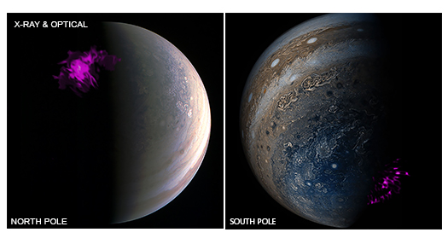
X-rays come from the hottest and most violent places in the Universe!
Stars:
being born, interacting, merging, dying
Black Holes:
accreting material: “active”; jets, tidal disruption
Galaxies and Clusters:
Very hot gas
Planets:
Jupiter’s aurorae
Triggered by magnetic unloading from Jupiter’s equatorial plasma sheet
→ Most types of celestial sources

Slide 4
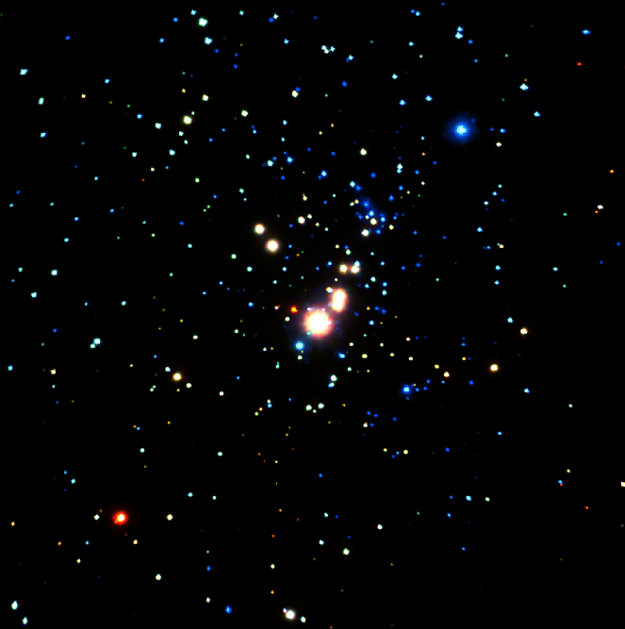
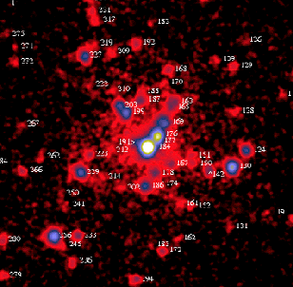
Exquisite Spatial Resolution
Orion Nebula
ROSAT:
~100 sources
Chandra (840 ks):
~1400 sources
Chandra is an excellent “Young star finder”
Colors indicate X-ray hardness
Major advances in our knowledge of young star populations
Stellar X-ray activity is key to determining exo-planet formation and habitability
0.75 lt yr
ROSAT
Chandra
Notes:
ROSAT ~100 sources, Chandra 1408 sources

Slide 5
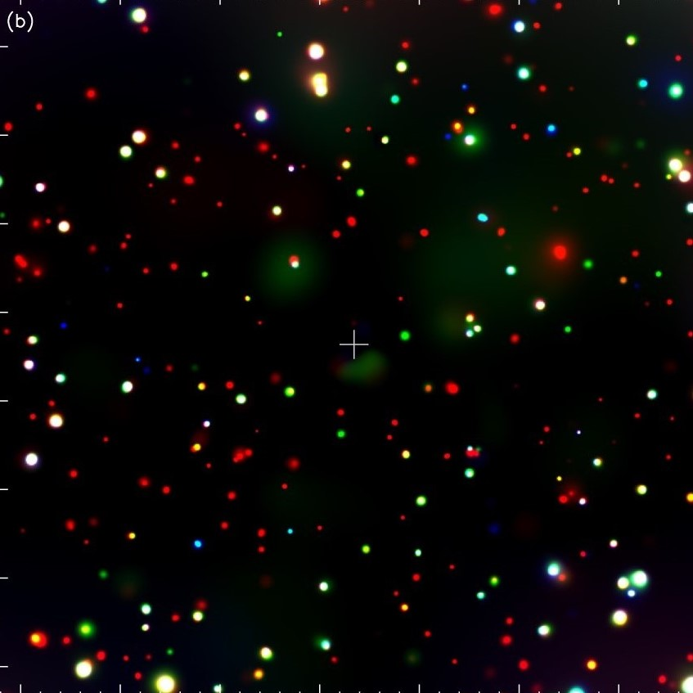
Cosmic X-ray Background
Primary Chandra Science Goal:
Resolve CXRB, observed to be ubiquitous in previous X-ray missions
Fully resolved to ~9 keV: Chandra Deep Field South (CDFS, 7 Ms)
Looks back ~12-13 Gyrs, ~10% current age of Universe
1000 sources, mostly Super Massive Black Holes
Source Density: 50,500 deg⁻²
Detects log L_{X}~42 at z>4
Hardness: wide range, including highly obscured sources
Chandra is a SMBH finder
1’
1’
Luo et al. 2017
Luo et al - check
Notes:
7 Ms -> 80 days, almost 3 months of exposure time over about 12 years.

Slide 6
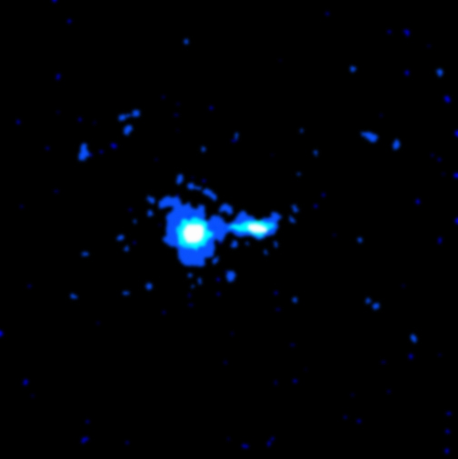
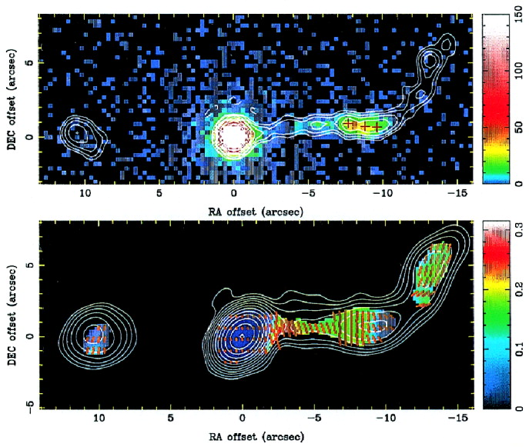
First Targeted Source Quasar: PKS 0637-75
Radio jet bend
Point Source to focus: Quasar, z=0.66
X-ray Jet visible: 9” long, (100 kpc)
Jet L~10^{44.6} erg s⁻¹
No X-rays beyond the jet bend
Radiation mechanisms:
Inverse-Compton/CMB, mildly relativistic (Tavecchio et al. 2000)
BUT
Ruled out by lack of Fermi GeV γ-ray emission (Meyer et al. 2015)
→Synchrotron emission from 2nd electron population
X-ray
Radio
Schwartz et al. 2000
Schwartz et al. 2000
Notes:
z~0.5, ~9.3 G lyrs

Slide 7
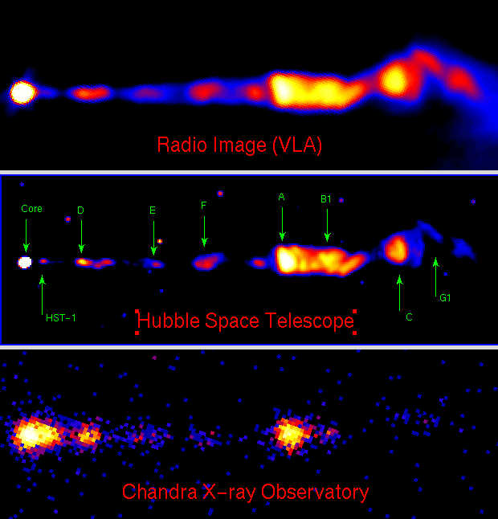
X-ray/Radio Jets in Quasar Messier 87
First image of BH horizon
(Event Horizon Telescope)
40 µarcsec, ~4 light days
Notes:
Largest galaxy in Virgo cluster

Slide 8
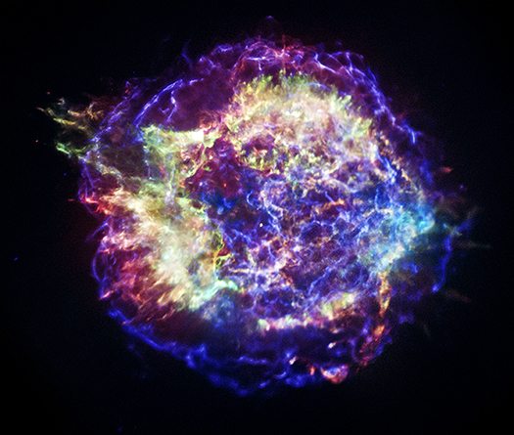
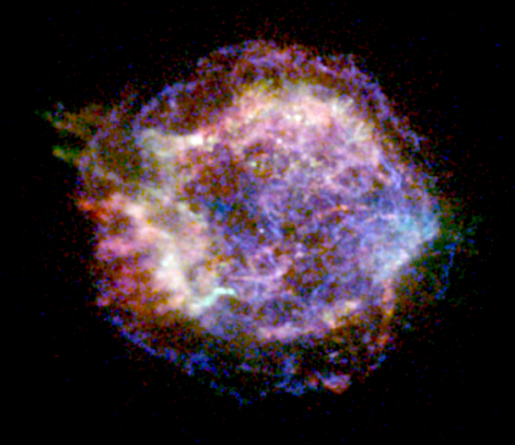
Official First Light (Aug 1999) Supernova Remnant: Cassiopeia A
Age: 320 years
Size: 29 lyrs
1 Msec Deep Image (12 days)
Chandra-discovered stellar remnant

Slide 9
Perseus Cluster Chandra sees the “invisible”
Notes:
1% visible, 9% X-ray, 90% dark matter, BCG is NGC 1275, 1000s galaxies

Slide 10
Cluster: MS 0735.6+7421 (z=0.216)
Hot X-ray-emitting gas dominates normal matter:10*stars
Site of star formation
Accretes onto central active nucleus
Radio jet:
pushes hot gas aside
depositing energy in intercluster medium
radio emission fills X-ray cavities (at low redshift)
“Feedback”: regulates star formation and SMBH growth
Largest continuous radio jet: > 400 kpc
Notes:
Z=0.216

Slide 11
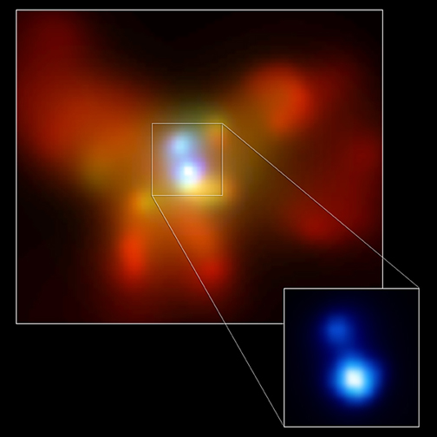
Binary Supermassive Black Holes
NGC 6240
Merging galaxy (optical: red)
Binary SMBHs (Chandra : blue)
SMBHs: 1kpc apart, will eventually merge
→ Hot topic since the LIGO detections of merging stellar mass BHs
Merging SMBHs are not detectable by LIGO, need detectors in space with larger baselines (ESA’s LISA)
D ~ 125 Mpc
Notes:
1 kpc apart! In core of the highly disturbed merging galaxy NGC6240

Slide 12
NGC 6240 Movie

Slide 13
X-rays confirm Active Binary Super-Massive Black Holes
SDSS J1254+0846 20 kpc separation Chandra (blue), Magellan (yellow)
MRK 739 3 kpc separation Chandra (white), SDSS (red)
Green et al. 2010
Koss et al. 2011
Binary AGN in ~10% galaxies, X-ray bright are in closer pairs (<15 kpc) (Koss et al.)
Numbers vs separation → Galaxy merger rate & binary SMBH merger rate

Slide 14
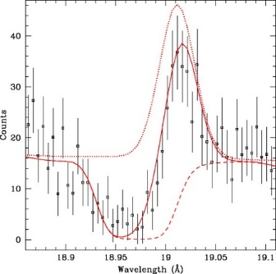
Grating Spectroscopy: NGC 3783
900 ks HETG Spectrum, z~0.01 active galaxy
2-phase clumpy absorber, high and low ionization, in pressure equilibrium
Outflow, v~750 km s⁻¹
Dynamical agreement with UV absorber
Variability → ~6 pc from SMBH
Mass outflow rate 0.2-4 M_{sun} yr⁻¹
Blended absorption and emission components, e.g. OVIII λ18.969
Krongold et al. 2003,2005
Notes:
X-ray & UV fit -> 5 warm absorbers, 2 being part of “same” system. Range of v (400-1000 km/s), ionisation parameter and NH (19-22), Fu et al

Slide 15
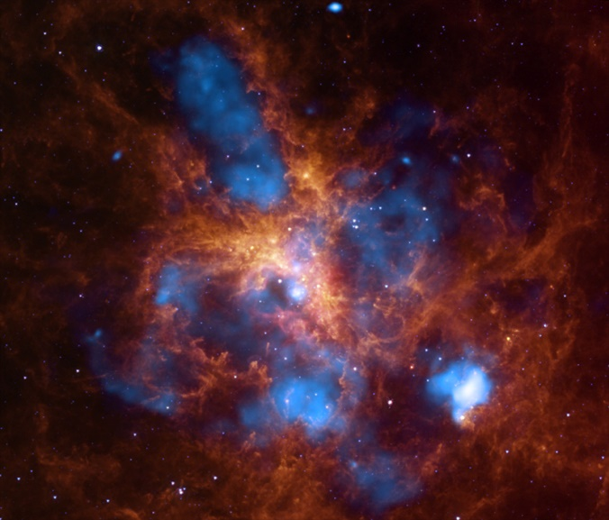
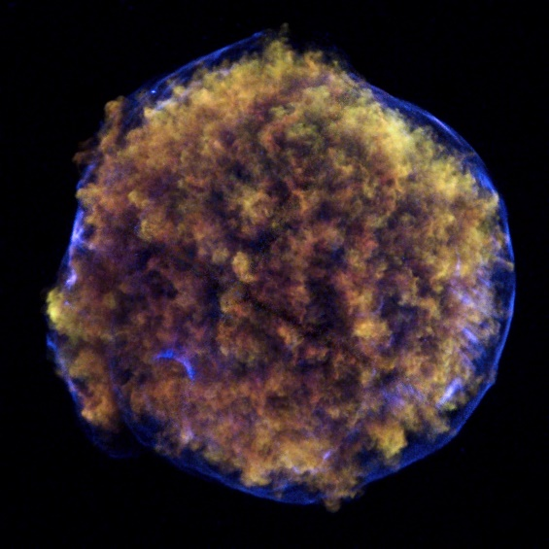
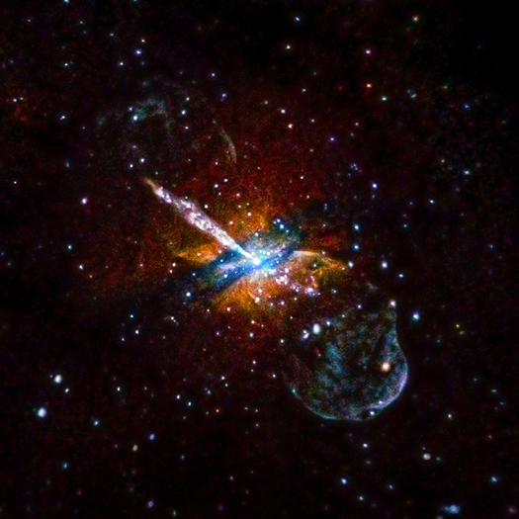
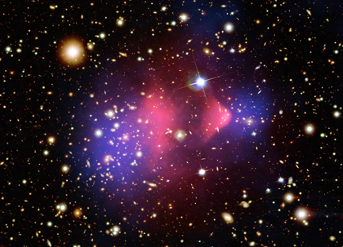
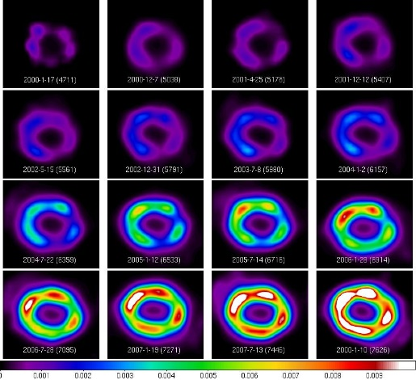
30 Doradus
Tycho
Cygnus A
Centaurus A
(X-ray only)
SN 1987A over time
Centaurus A
X-ray Only
Bullet Cluster

