Slide 1
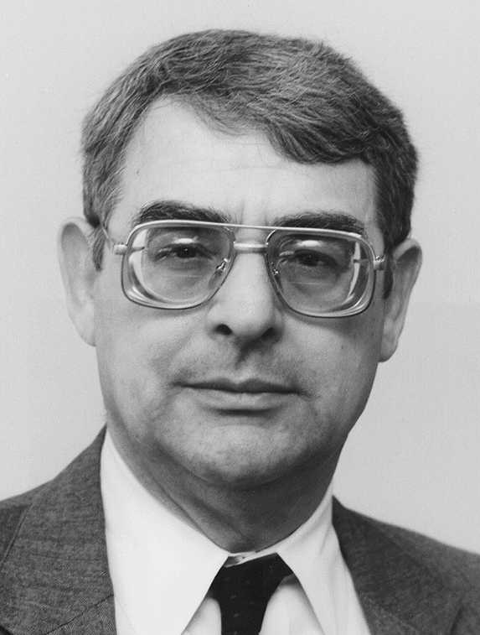
How Working on Uhuru Changed My Life
Prof. Lynn Cominsky
Sonoma State University
May 30, 2019

Slide 2
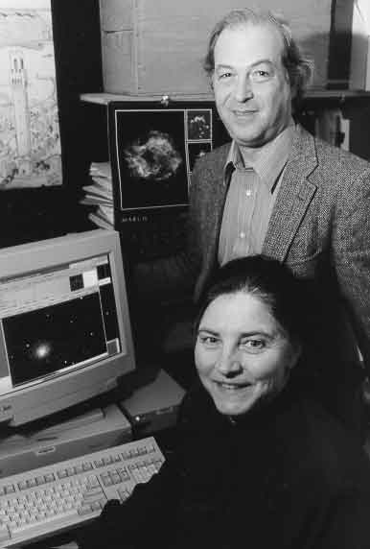
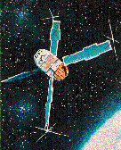
Harvard -Smithsonian Center for Astrophysics (1975-1977)
First data aide hired to help analyze data from Uhuru in Giacconi’s group
Uhuru (aka SAS-A)
60 Garden Street Cambridge, MA
Drs. Bill Forman and Christine Jones

Slide 3
Analyzing transient x-ray sources in the galactic plane using Uhuru data
I still have the original binder with all the plots of all the galactic plane sources (and then some)!
GX17+2

Slide 4
The only paper I co-authored with Giacconi

Slide 5
And the rest is (my personal) history…
Giacconi’s group at CfA was where I met my first woman science mentor (Christine Jones) and where I had an amazing opportunity to mentor others (Meg Urry, Peter Saulson)
I was encouraged to be an author on three papers during my 2.5 years at SAO – two as first authors + the 4U catalog
Work on the 4U catalog led to discovery (at MIT as a first-year grad student) of the first transient X-ray pulsar (4U0115+63)
I fell in love with the X-ray Universe and grabbed the chance to do “science fiction for a living”
And it was all possible because I answered a job ad for a “data aide” when I graduated from college in January 1975….
Thank you Riccardo!

