Slide 1
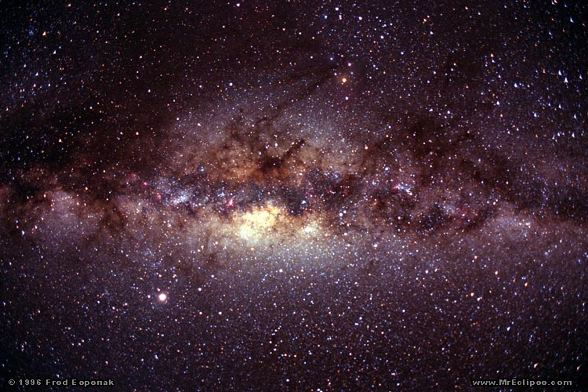
Gravitational Lensing
Rosanne Di Stefano
April 18, 2018

Slide 2
A Universe of Light Curves
Rosanne Di Stefano
April 18, 2018

Slide 3
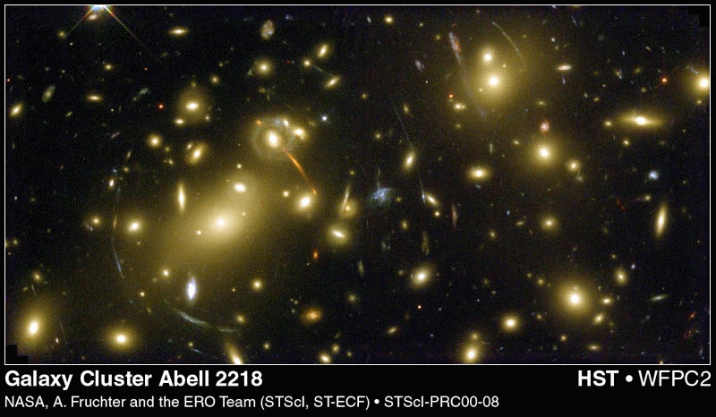
Notes:
Note the arcs—these are composed of the images of distant galaxies that have been lensed by intervening matter. These images are stable over human lifetimes and over the lifetimes of human civilizations. Ine can trace almost complete rings that trace the Einstein rings of massive lenses. Cosmic lensing, which produced these effects was a lively topic of discussion at the meeting, but during conversations, a lot of attention was paid to the not-yet observed phenomenon of microlensing, so called because the astrometric effects occurred on scales too small to be resolved. Instead, the signals would be in the time domain.
Abell 2218, HST, WFPC2, Fruchter and ERO team (STSci)

Slide 4
Notes:
Note the arcs—these are composed of the images of distant galaxies that have been lensed by intervening matter. These images are stable over human lifetimes and over the lifetimes of human civilizations. Ine can trace almost complete rings that trace the Einstein rings of massive lenses. Cosmic lensing, which produced these effects was a lively topic of discussion at the meeting, but during conversations, a lot of attention was paid to the not-yet observed phenomenon of microlensing, so called because the astrometric effects occurred on scales too small to be resolved. Instead, the signals would be in the time domain.
Abell 2218, HST, WFPC2, Fruchter and ERO team (STSci)

Slide 5
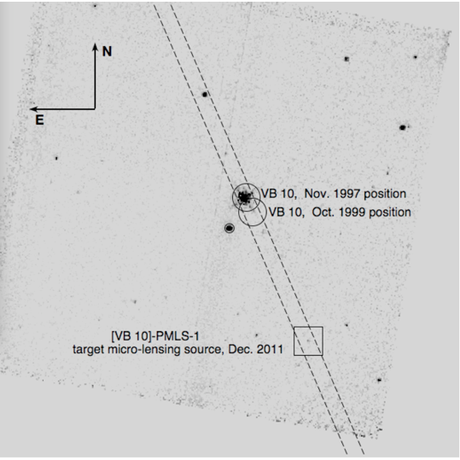
Hubble Space Telescope
WFPC2 image, epoch=1997
10’’

Slide 6
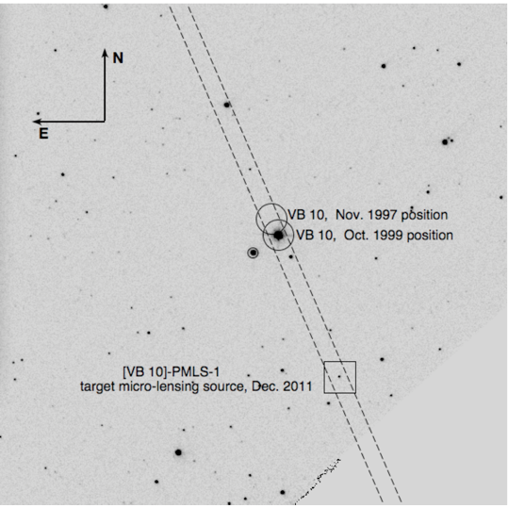

Hubble Space Telescope
WFPC2 image, epoch=1999
10’’

Slide 7
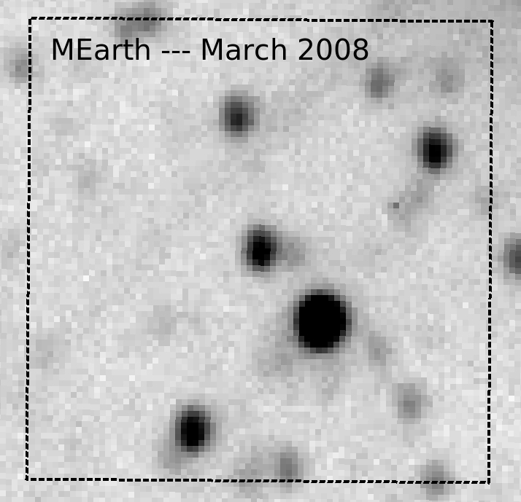
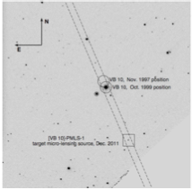

Slide 8
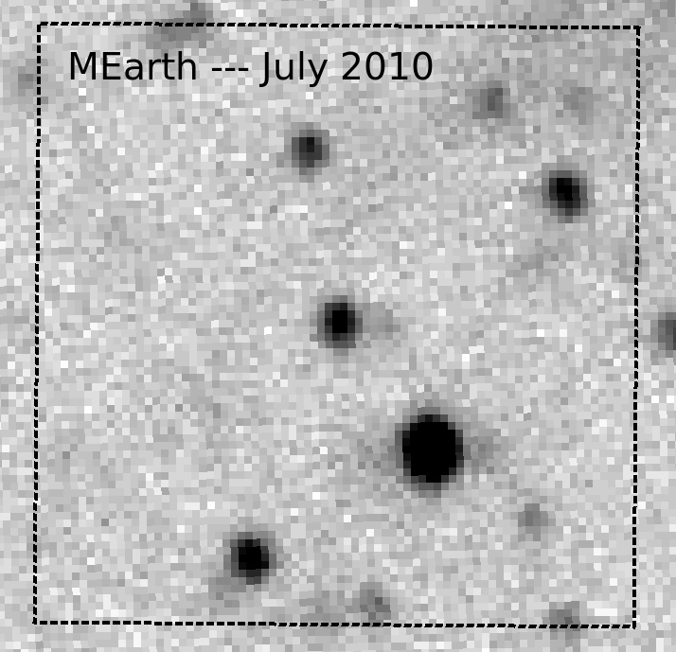

Slide 9
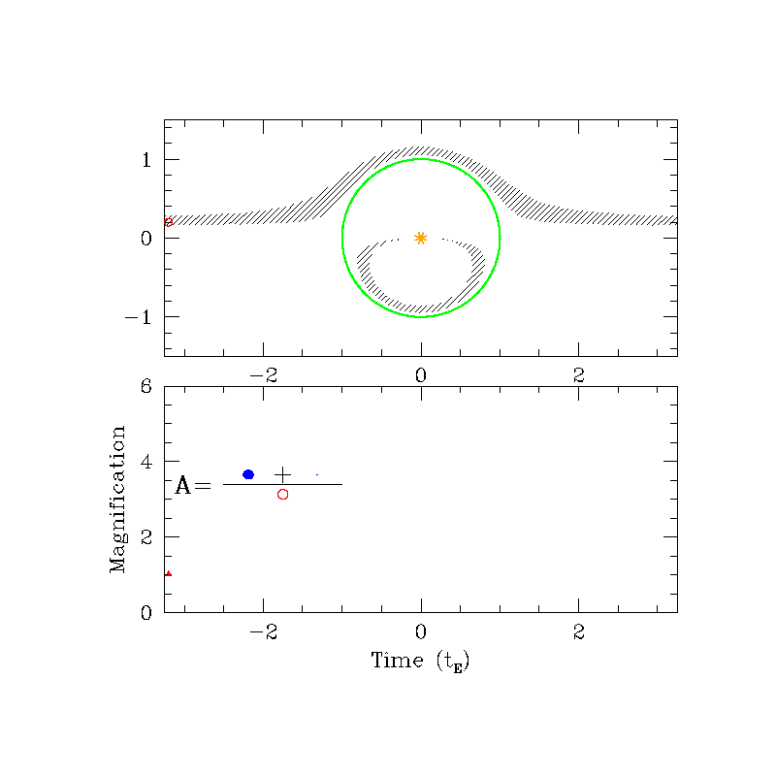
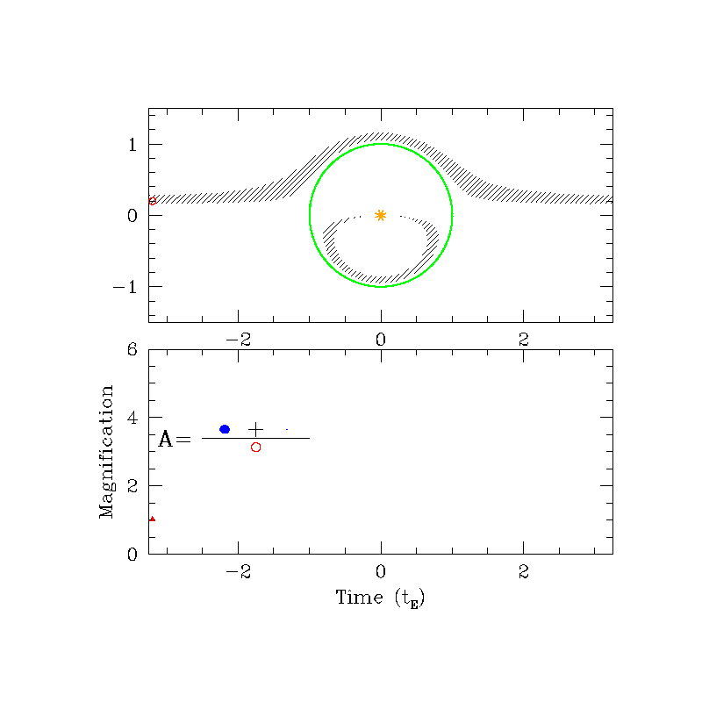

Slide 10
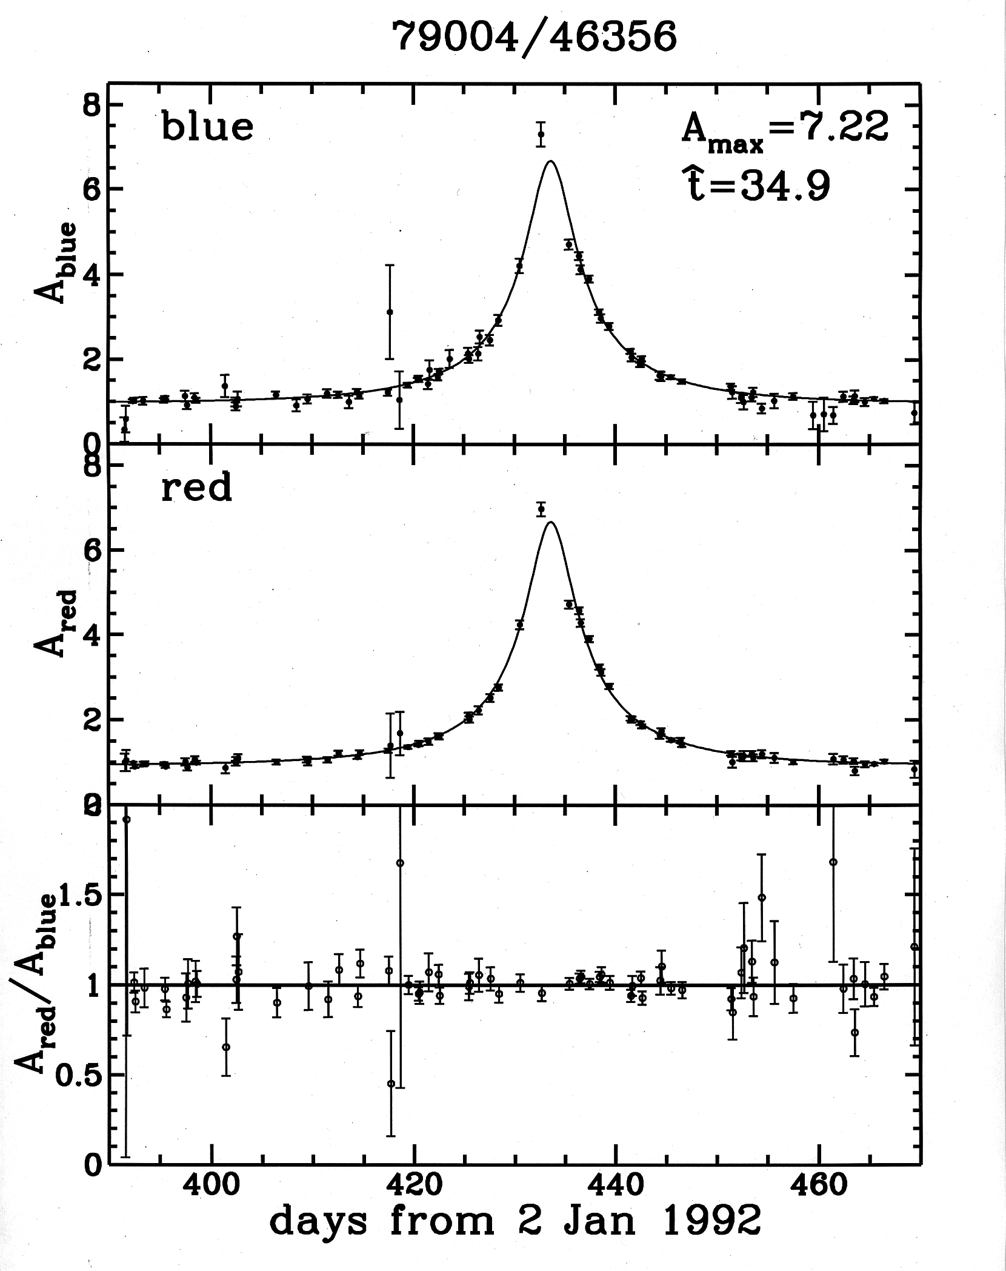
The lightcurve for the 1st MACHO microlensing event.

Slide 11
MUST BE: “symmetric, achromatic, occur only once”.
Highly degenerate!

Slide 12
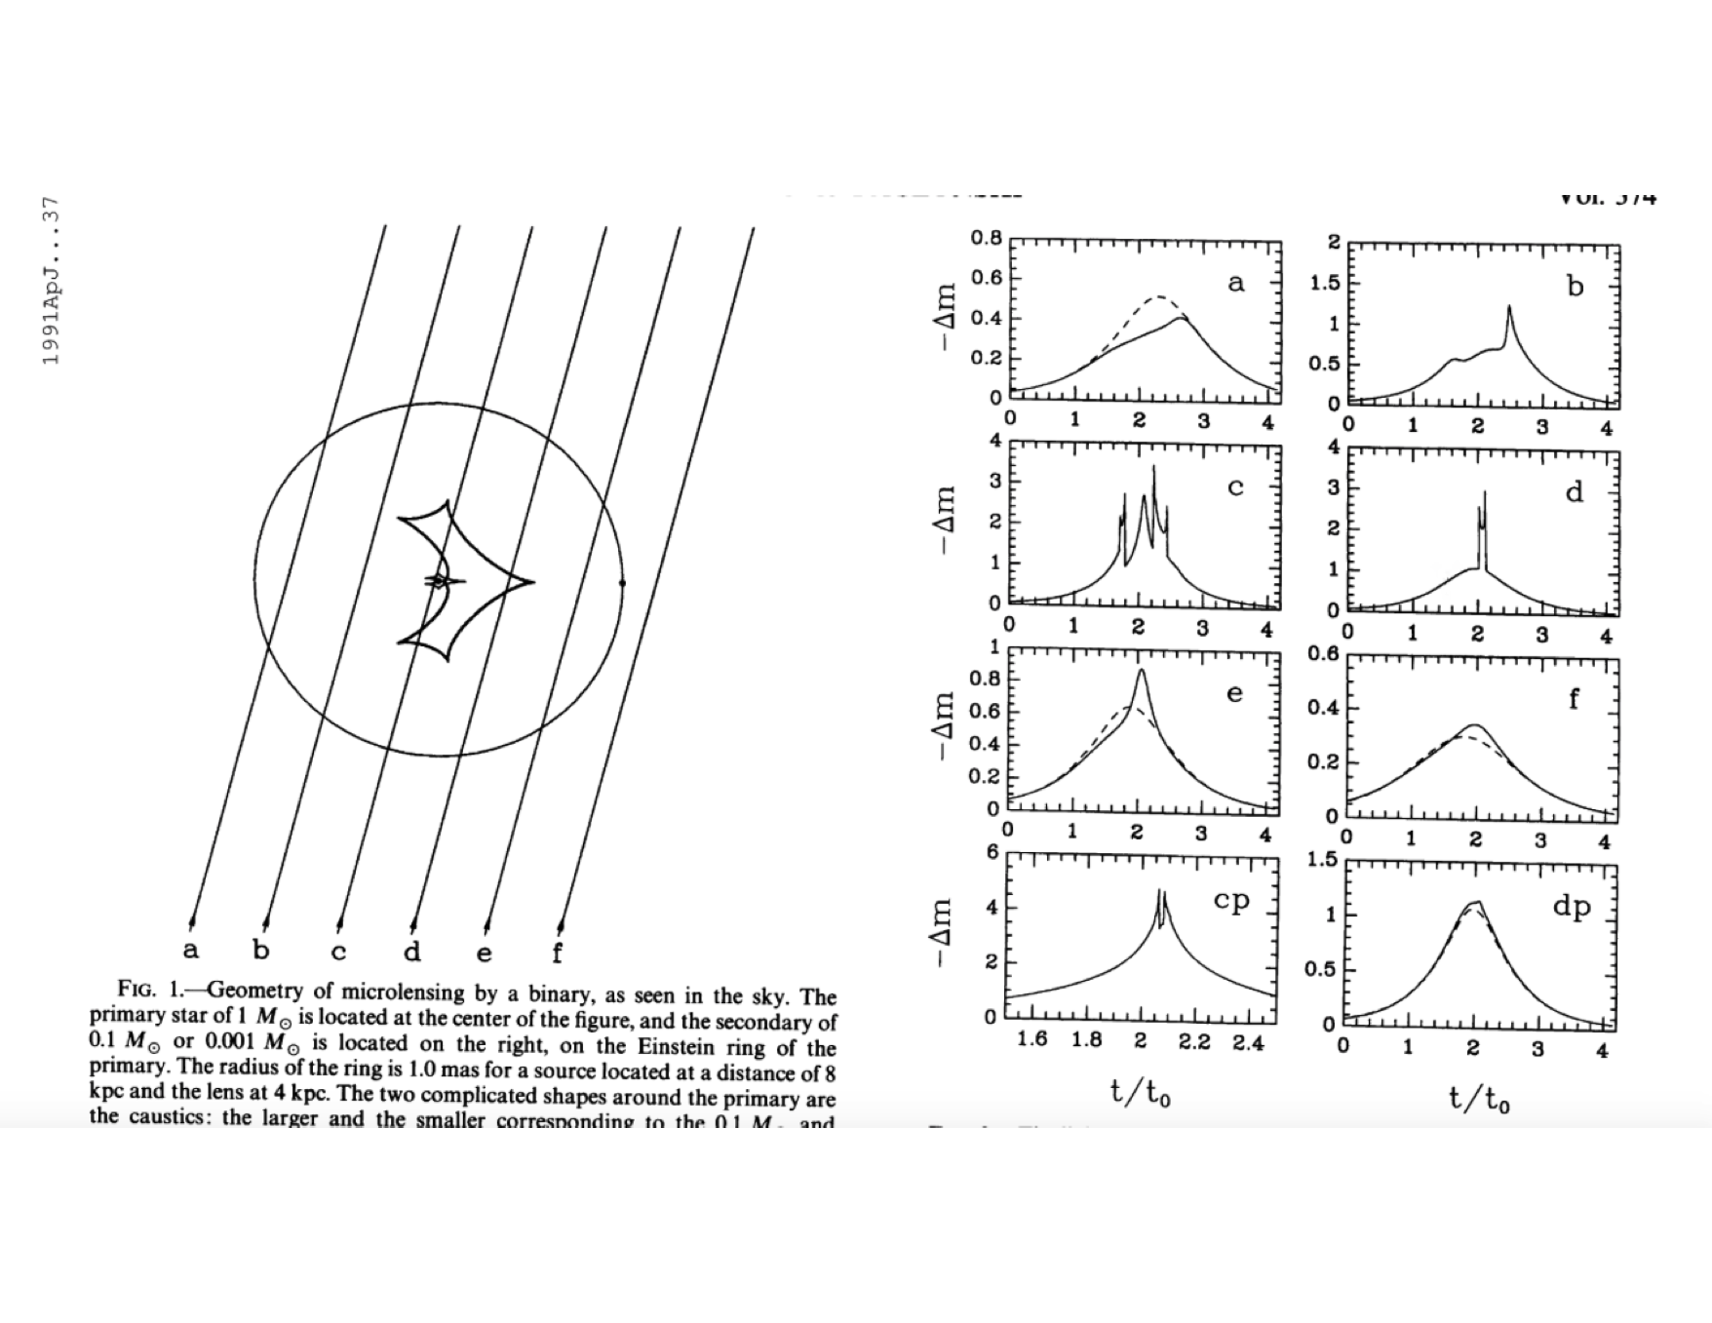
MUST BE: “symmetric, achromatic, occur only once”.

Slide 13
Strategy
Create a library of light curves.
Sample determined by variations.
Identify relevant regions of parameter space.
4. Find best fits.

Slide 14
Strategy
Create a library of light curves.
Sample determined by variations.
Identify relevant regions of parameter space.
4. Find best fits.
A new type of degeneracy.

Slide 15
First binary lens (Udalski et al. 2004).
From the data to the model: computational and mathematical approaches to recognizing “unusual” events. (Many, including Mao & RD 2005, RD & Mao 2005, RD & Esin 2005, Kamionkowski 2005, RD & Perna 2007.)
The field moved to focus on the special case of planets.
Notes:
Wozniak et a.l:

Slide 16
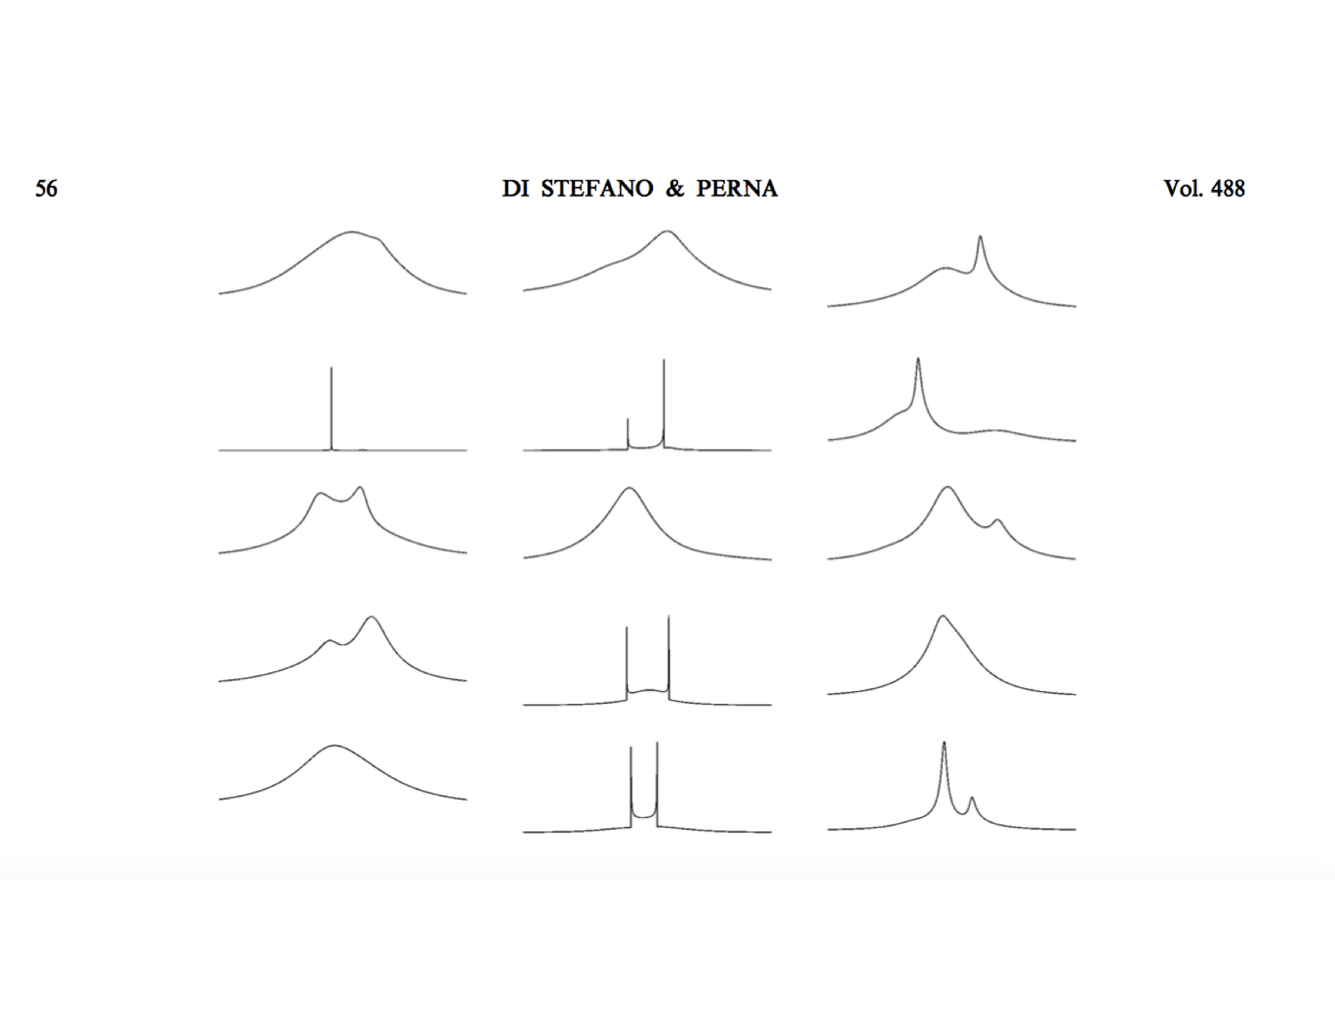

Slide 17
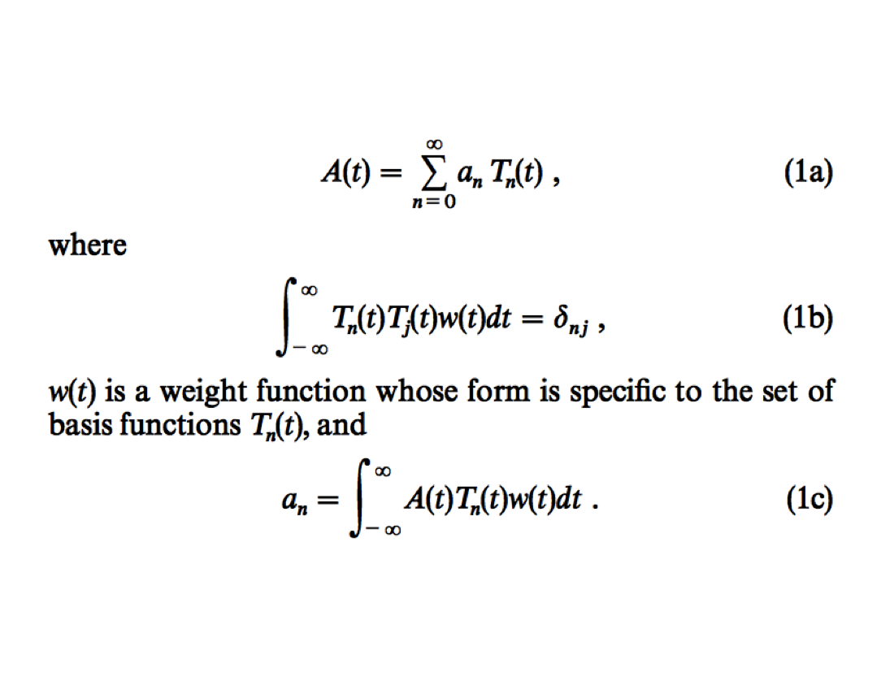

Slide 18
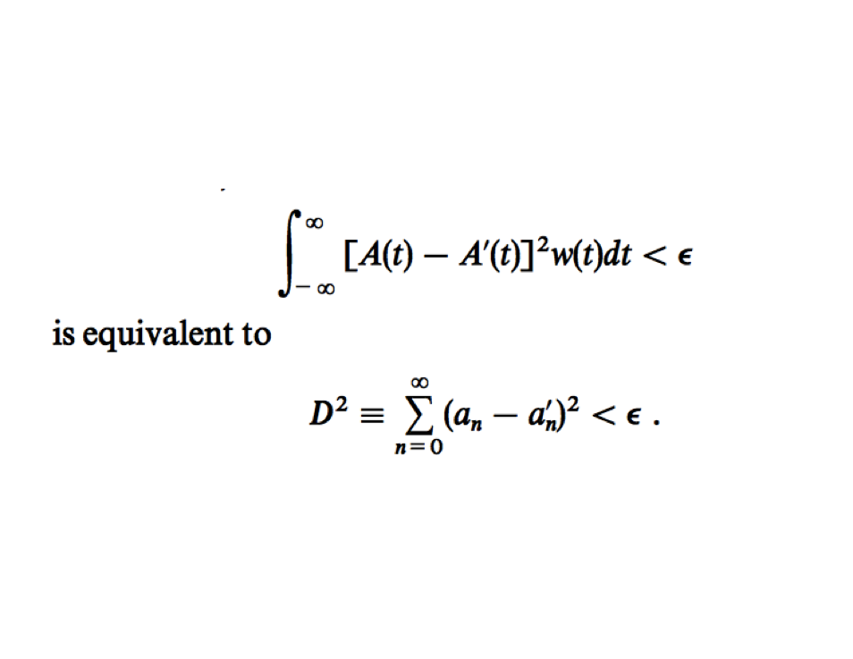

Slide 19
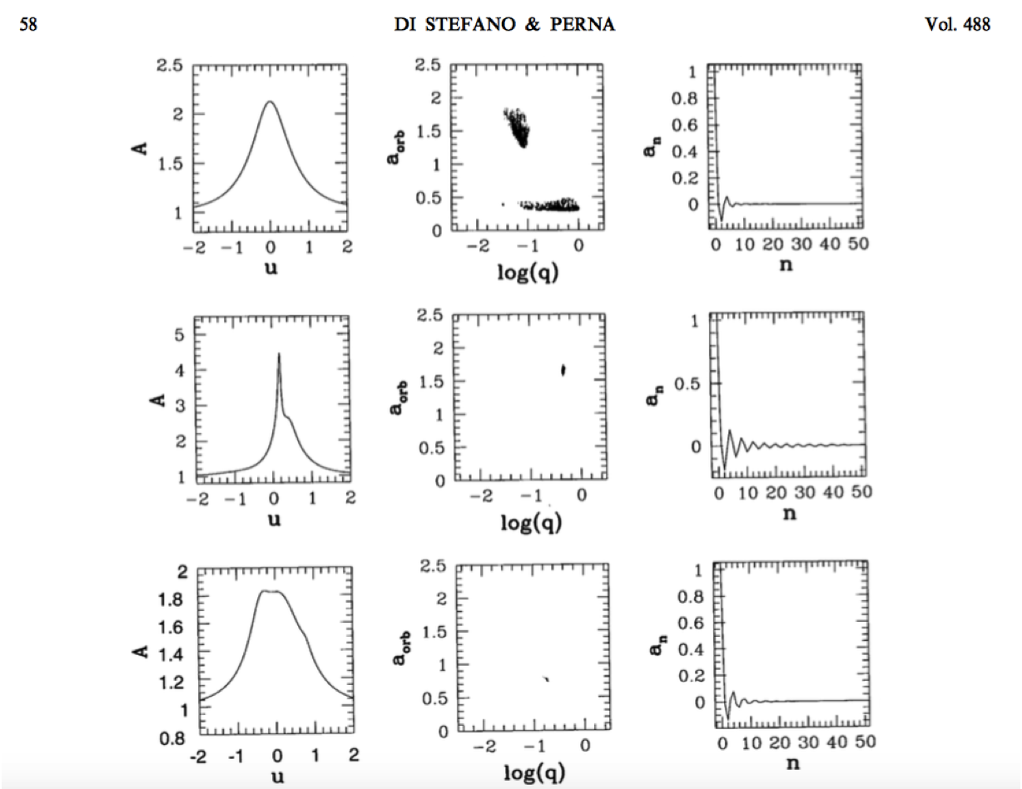

Slide 20
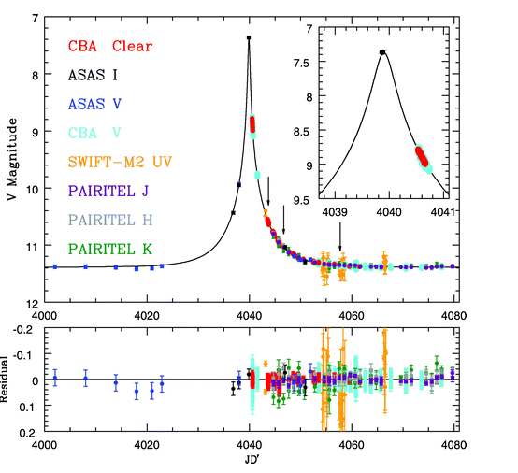
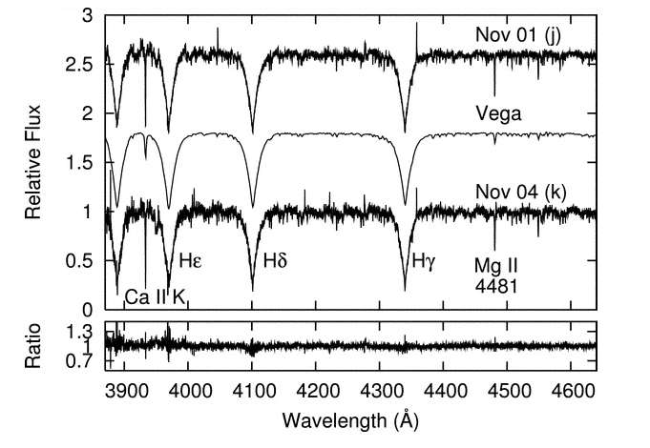
The Tago Event: the source star is at 1 kpc.
Fukui et al. 2007;
Gaudi et al. 2008
Notes:
TAGO event, discovered by an amateur on 31 October 2006, monitored by professional and amateurs around the world, including

Slide 21
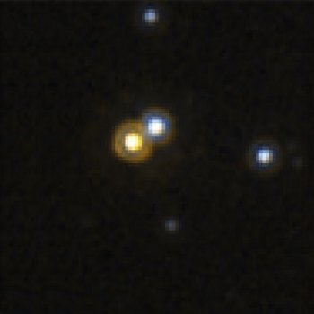
MACHO-LMC-5
Notes:
Talk about MACHO LMC-5,
Gould 2009
Tago event

Slide 22
Matches give magnitudes in several filters, and may (generally with more work) also yield proper motions.

Slide 23
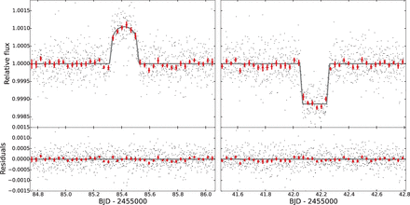
Binary self-lensing
Kruse & Agol 2014, Science, 344, 275.
A solar-mass star in an 88.18 day orbit with a ED of 0.63 solar masses.
Notes:
The eclipse of the WD produces a dip—T_WD must be ~10^4 K.
Mass of the G dwarf is about a solar mass, the WD is ~ 0,63 M_sun.; 88.18 day or bital period.

Slide 24
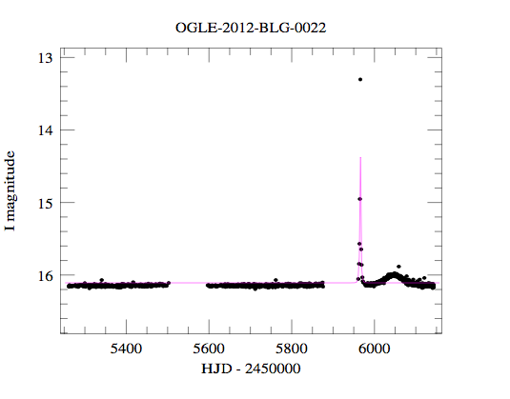

Slide 25
Stellar Mass Black Holes and Neutron Stars:
Short-duration events

Slide 26
The zone for
“resonant lensing”.
In this case, the
orbital period is
short enough that
planet detection
Is all but certain.

Slide 27
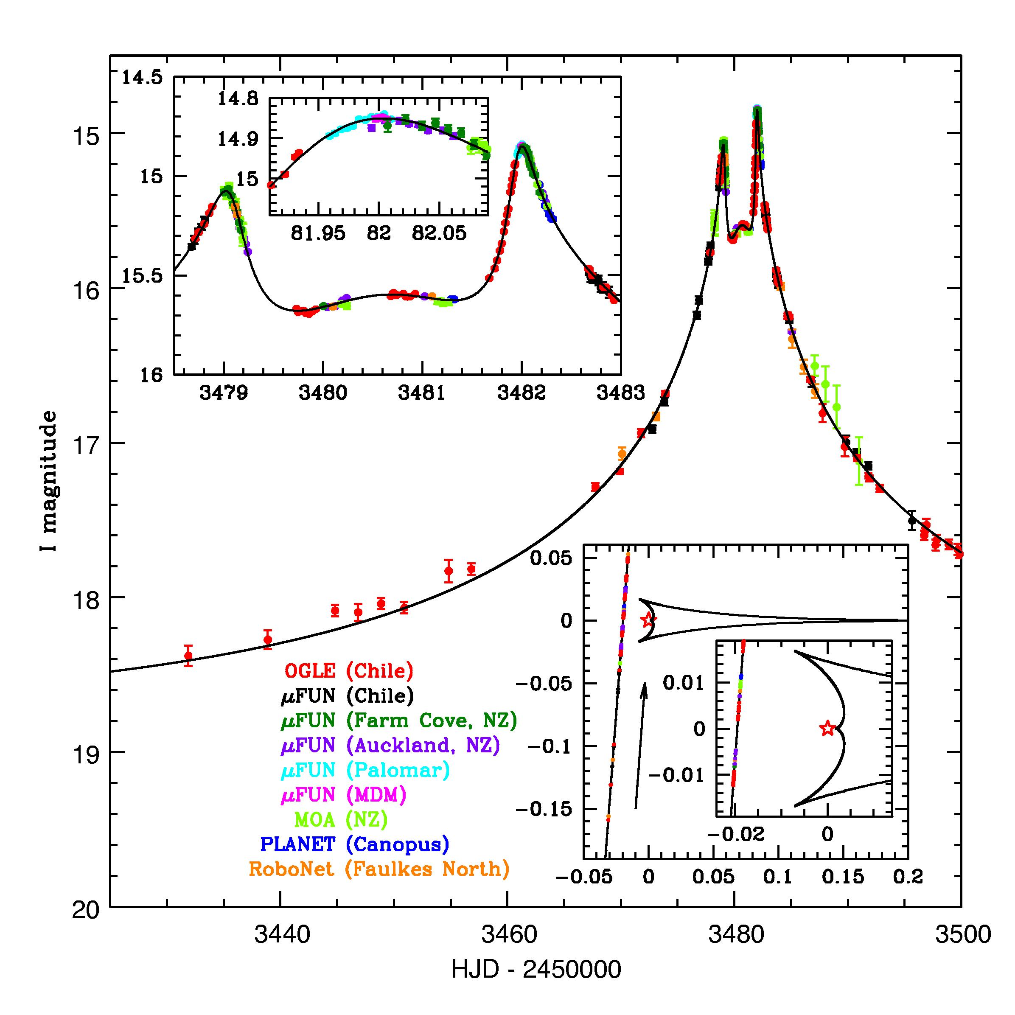
Alerts are called.
Must predict high magnification or other markers associated with possible planets.
Monitoring by a worldwide network of telescopes.
Monitoring can be nearly continuous over an interval of hours.

Slide 28
Lensing events have discovered 12-16
exoplanets. (~2% of the total)
We could do better by searching over a wider range of orbital separations.

Slide 29
Close-orbit
planets:
α ≤ 0.5
Peaks at
1/α - α

Slide 30
A hot
Jupiter,
orbiting a
star of
0.8 M_{sun}.
Each deviation is distinctive, and lasts for ~a day.
The deviations repeat.

Slide 31
Nepune,
orbiting a star of
0.25 M_{sun}.
For close-obit planets, the values of the mass ratio and orbital separation can be determined. If the star is nearby, the degeneracy can be removed.

Slide 33
Wide-orbit
planets create
signatures
at early and
late times.
(Lower
probability)
Close-orbit
planets
create small,
repeating
signatures
that start
early.
(Almost certain
detection)

Slide 34
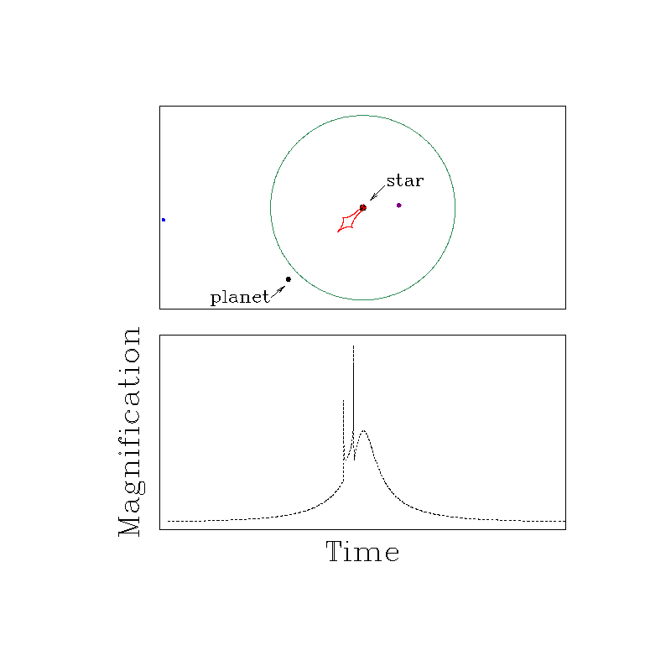
OGLE-2003-BLG-135/MOA-2003-BLG-21
Notes:
This is the way we had expected to identify lensing by planets.
alpha:0.5-2.
Work to detect short-lived deviations, due to planets, in long events, had been underway in an intensive way since the mid 1990’s. (Tell about notes for telecon in 1996.) This is the first planet-lens event discovered by microlensing. HST images in 2005 (sep. between source and lens 0.7 mas) found color offset, enough to constrain model:
The lens in about 0.6 M_sun, the planet had m-2.6 M_J, about 6 kpc away.

Slide 35
Wide-orbit
planets: α > 2
R
RD & Scalzo 1999a, b;
Sumi et al. 2011
(free?)
RD 2012a, b

Slide 36
Earth,
orbiting a star of
0.25 M_{sun}.

Slide 38
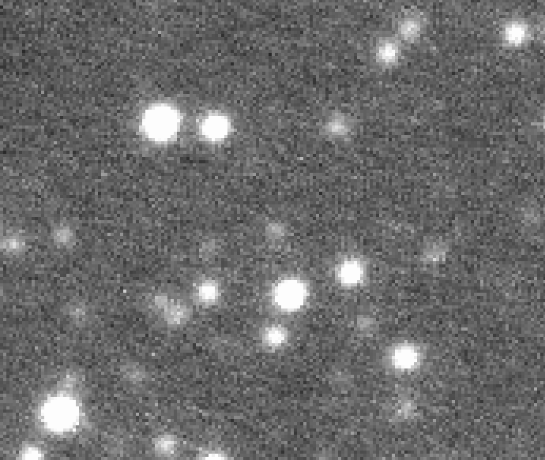
Hubble Space Telescope
WFPC2 image, epoch=1999
10’’
MDM Observatory
RETROCAM, 5 Oct. 2011

Slide 39
10’’

